Slide 1
Some NSF Funding Opportunities for the MASS Community
Micah Beck
Program Director, National Science Foundation
Computer and Information Science and Engineering(CISE)
Office of Advanced Cyberinfrastructure (OAC)
mbeck@nsf.gov
MASS 2019, Monterey Nov 6

Slide 2
NSF Programs I am directly involved in
Cyberinfrastructure for Sustained Scientific Innovation (CSSI)
NSF 19-548 (Nov 1, 2019)
Combines previous Software and Data Programs
Science driven – large awards are co-Funded by research divisions
Cybersecurity Innovation for Cyberinfrastructure (CICI)
No 2020 Solicitation announced
Applied solutions to support research & education
Secure Scientific Cyberinfrastructure (SSC)
Research Data Protection (RDP)
Cybersecurity Center of Excellence (CCoE)

Slide 3
NSF Programs I am directly involved in
Navigating the New Arctic (NNA)
NSF 20-514 (deadline Feb 11, 2020)
One of NSF’s Interdivisional “10 Big Ideas”
Sensing, transmission, management, processing and use of data
Planning grants & large (team) projects
Climate impact and use of data, not just arctic field work

Slide 4
Programs I am not directly involved in
Major Research Infrastructure (MRI)
NSF 18-513 $100K to $4M
All NSF divisions are eligible
Funds instruments rather than just hardware acquisition
Facilities
Software
Analytics
Data sharing and management
Matching is sometimes required

Slide 5
Major Research Instrumentation (MRI)
NSF 18-513
“Increase access to shared-use/multi-user instrumentation for scientific and engineering research and research training. MRI is intended to be a capacity-building program that builds research capabilities across diverse institution types.”
Goals:
Support the acquisition or state of the art or foster the development of the next generation of instrumentation
Improve access to, and increased use of, modern research and research training instrumentation by a diverse workforce of scientists, engineers, and graduate and undergraduate students;
Enable collaborations to create well-equipped research environments that integrate research with research training;
Promoting substantive and meaningful partnerships for instrument development between the academic and private sectors.

Slide 6
Major Research Instrumentation (MRI)
NSF 18-513
“Increase access to shared-use/multi-user instrumentation for scientific and engineering research and research training. MRI is intended to be a capacity-building program that builds research capabilities across diverse institution types.”
Track 1: Track 1 MRI proposals are those that request funds from NSF greater than or equal to $100,000 and less than $1,000,000.
Track 2: Track 2 MRI proposals are those that request funds from NSF greater than or equal to $1,000,000 up to and including $4,000,000.
Two Track1 and one Track 2 for each institution.
Cost sharing of precisely 30% of the total project cost is required for Ph.D.-granting institutions of higher education and for non-degree-granting organizations
Next deadline, Jan 21, 2020
https://www.nsf.gov/funding/pgm_summ.jsp?pims_id=5260

Slide 7
Programs I am not directly involved in
Platforms for Advanced Wireless Research (PAWR)
https://advancedwireless.org/
Program office issuing multiple Requests for Proposals
Current competition will announce finalists by Feb 2020
Campus Cyberinfrastructure
NSF 20-507 (Jan 21, 2020)
Campus Infrastructure oriented
Practical tools, innovative applicaitons

Slide 8
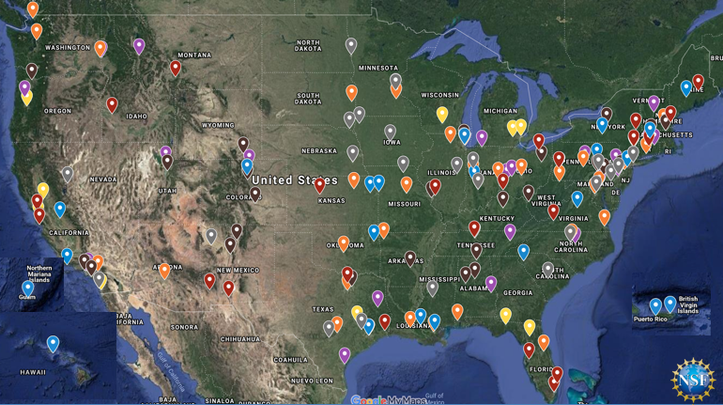
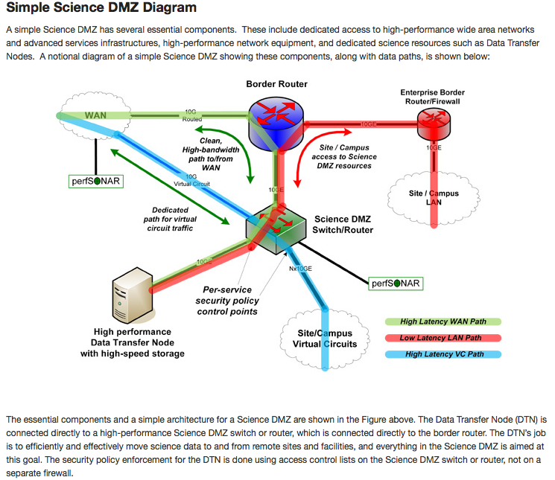
The Campus Cyberinfrastructure (CC*) Program
Networking as a fundamental layer and underpinning of Cyberinfrastructure, driven by scientific R&E needs
Most awards go to 10/100 Gbps Campus networking upgrades, external connectivity to the national R&E fabric, and campus border redesign prioritizing science traffic.
~290 awards totaling >$100M have been made across 49 states and jurisdictions in CC* since 2012 (map below does not show 2019 awards)
CC* emphasizes strong campus level partnerships between researchers/teachers and campus IT leadership

Slide 9
CC* 20-507 - Campus Cyberinfrastructure
(Search for “NSF CC* 20-507” online to find the full solicitation)
$14M-$20M in expected award funding
Proposals due January 21, 2020
Area #1 – Campus Network upgrades
10/100Gbps inter- and intra-campus networking
Re-design of campus border to prioritize science flows
Area #2 – Regional coordination for Small Institutions
Establishing r&e network connectivity for multiple under-resourced institutions
Area #3 – Networking Integration and Applied Innovation
Applied R&D in networking motivated by science use cases (e.g. SDN on campus)
Area #4 – Campus Computing
Shared cluster cycles for campus-wide science
Area #5 – Cyber Team – R&E CI-based Regional Facilitation
Regionally coordinated teams of CI practitioners/professionals/experts
Area #6 – Planning Grants and CI-Research Alignment

Slide 10
Program-wide Criteria for CC* proposals
The extent to which the work provides a needed capability required by science, engineering and education.
A partnership among researchers/educators and campus IT leadership
A Cyberinfrastructure Plan - To what extent is the planned cyberinfrastructure likely to enhance capacity for discovery, innovation, and education in science and engineering? How well does the plan as presented position the proposing institution(s) for future cyberinfrastructure development? How well does the cyberinfrastructure plan support and integrate with the institutions' science and technology plan? Are IPv6 deployment and InCommon Federation addressed? Are the activities described in the proposal consistent with the institution's cyberinfrastructure plan?
Where relevant, addressing appropriate cybersecurity issues and challenges
Represent ongoing opportunities for student engagement

Slide 11
Programs I am not directly involved in
CISE Core Research Programs
NSF 19-589 (Sept-Nov 2020 deadline)
Specific program webpages for each CISE directorate/program
OAC Core Research (OAC Core)
CCF:
Algorithmic Foundations (AF)
Communications and Information Foundations (CIF)
Foundations of Emerging Technologies (FET)
Software and Hardware Foundations (SHF)
CNS Core (CNS Core) program
IIS:
Cyber-Human Systems (CHS) program
Information Integration and Informatics (III) program
Robust Intelligence (RI) program

Slide 12
Questions on NSF Programs?

