Slide 1

ICCCN 2019 – Valencia/ES
A Novel IoT Protocol Architecture:
Efficiency Through Data and Functionality Sharing Across Layers
Vinícius G. Guimarães, Adolfo Bauchspiess,
Renato M. de Moraes (CI/UFPE-BR), Katia Obraczka (UCSC-USA)
July 29, 2019
University of Brasília/Brazil
Electrical Engineering Department

Slide 2
Outline
Introduction
IoT
Related works
Motivations
Objectives
Problem description
IoTUS framework
Description
Example with IoTUS
Packet build
Message aggregation
Methodology
Results
Conclusions & Future work

Slide 3
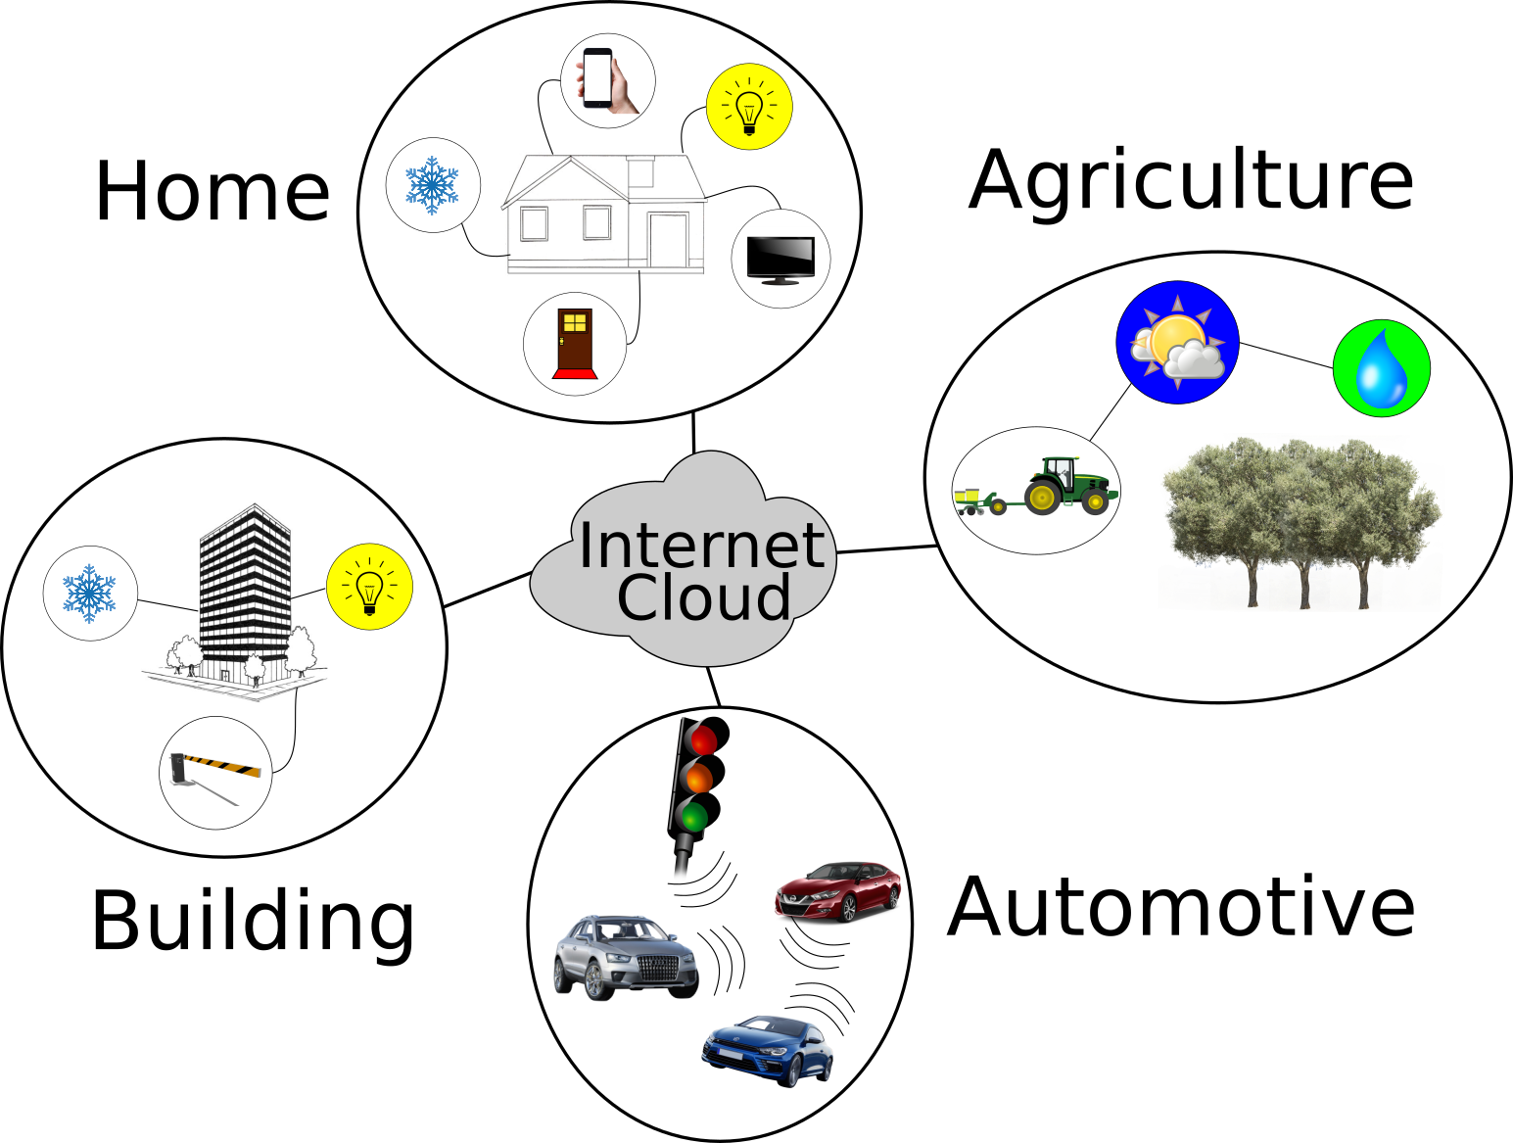
Internet of Things (IoT)

Slide 4
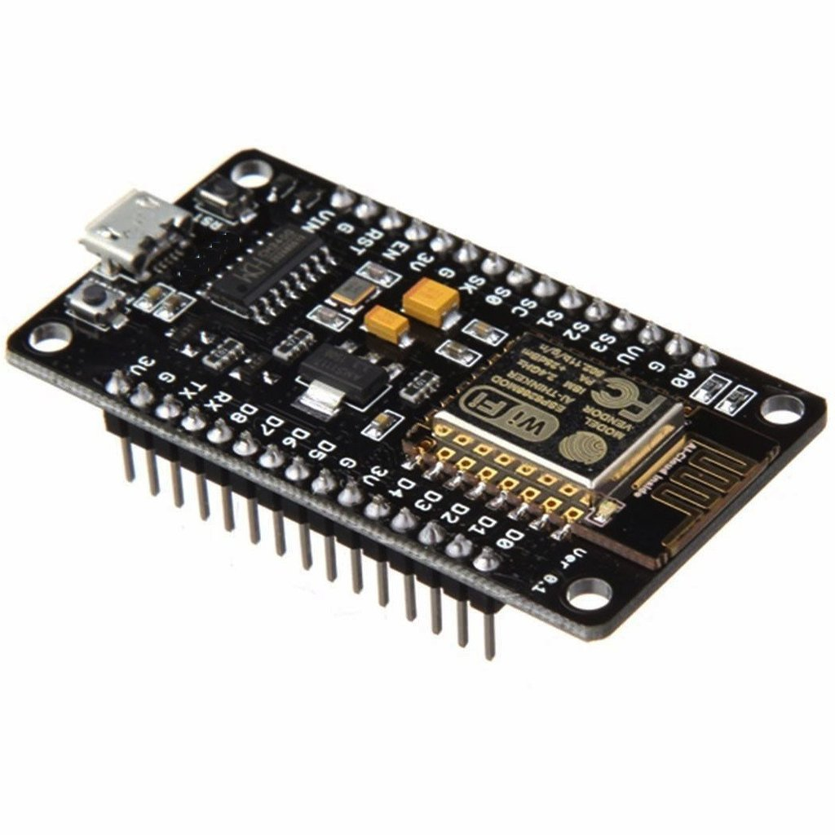


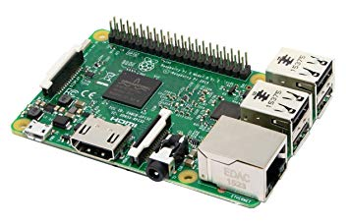


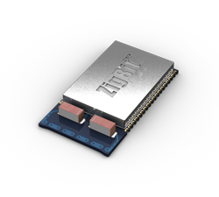
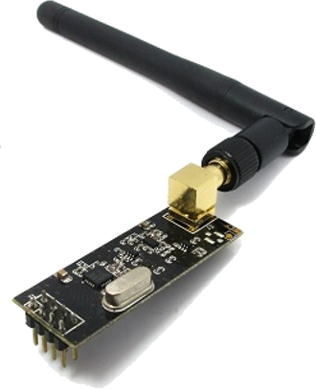
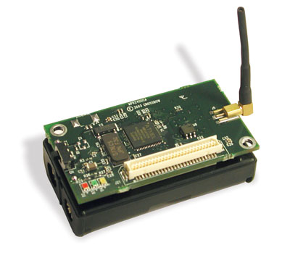
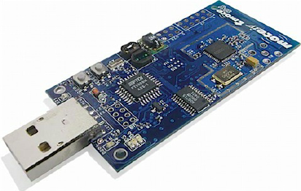
IoT communication versatility
Bluetooth
Raspberry Pi
ESP8266
Wi-Fi/Ethernet
Mica Z
TMote Sky
Zigbit
NRF24L01

Slide 5
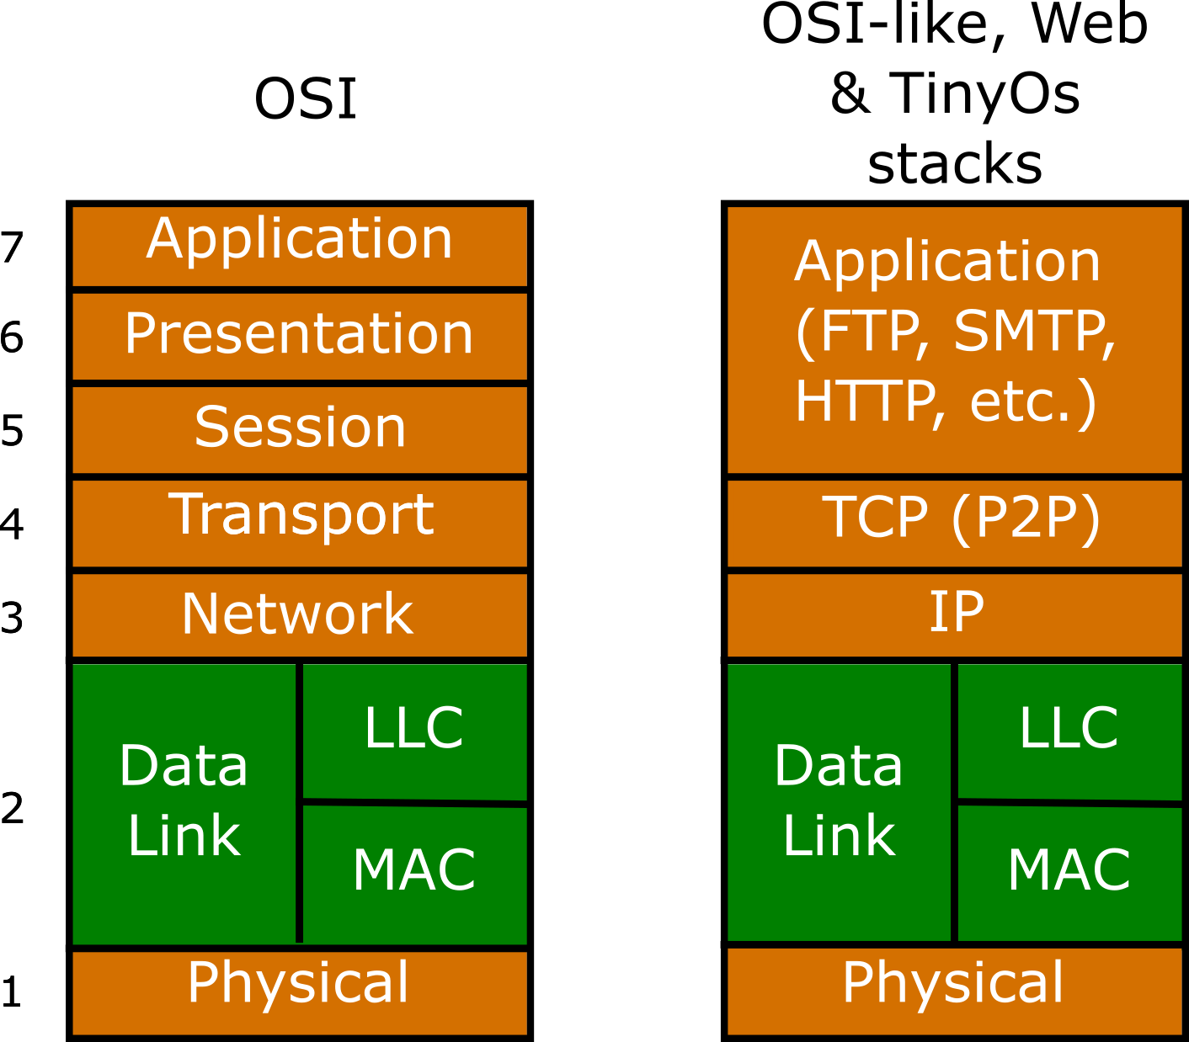
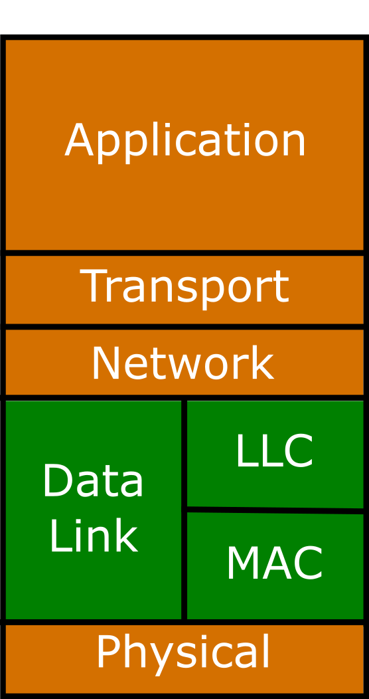
Protocol Stacks
TCP/IP
layered Stack
Notes:
OSI – Open Systems Interconnection
Explicar que nós chamamos a stack tradicional modificada do ContikiOS de “RIME”

Slide 6
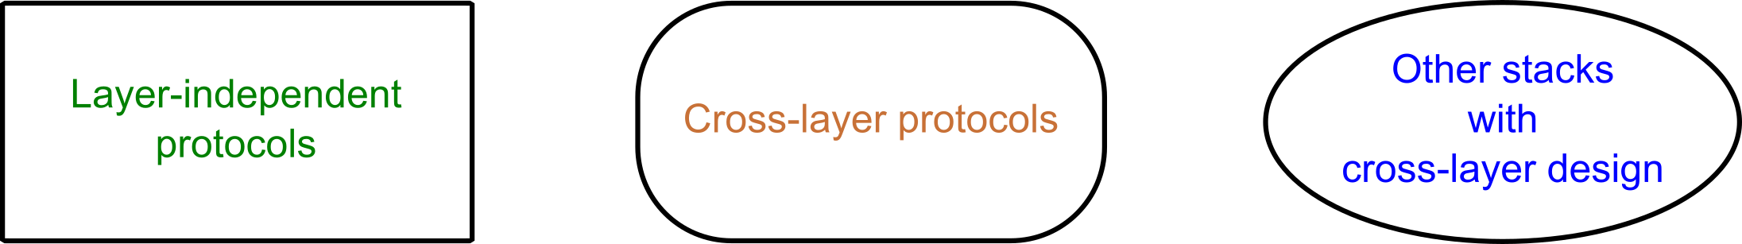
Protocols and stacks
ContikiMAC
IEEE 802.15.4
IPv6
RPL
…
FLIP
6LowPAN
…
CLAMP
Rime Stack
XLM
UCLEAH
TinyXXL
…

Slide 7
Motivations
Increasing number of IoT applications;
Energy efficiency in wireless communications;
Cross-layer designs’ benefits and challenges.

Slide 8
Objectives
General objectives:
Improve energy efficiency in IoT networks;
Specific objectives:
Identify opportunities from the state of the art of IoT;
Propose and develop a framework to address cross-layer, aggregation, and functions for energy saving;

Slide 9
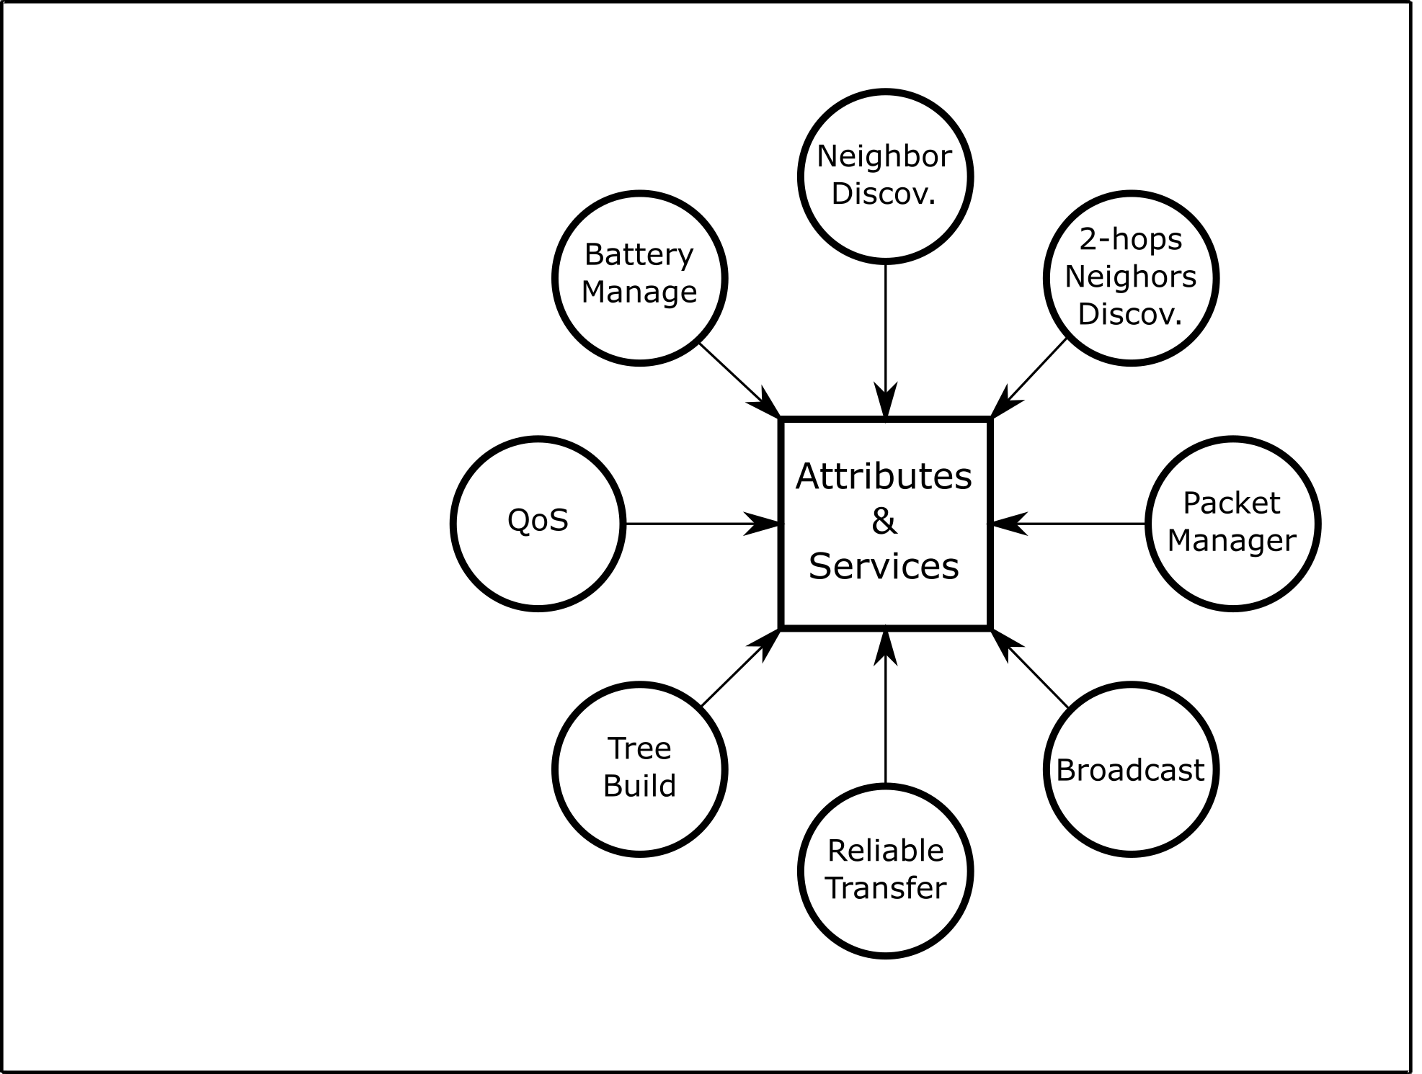
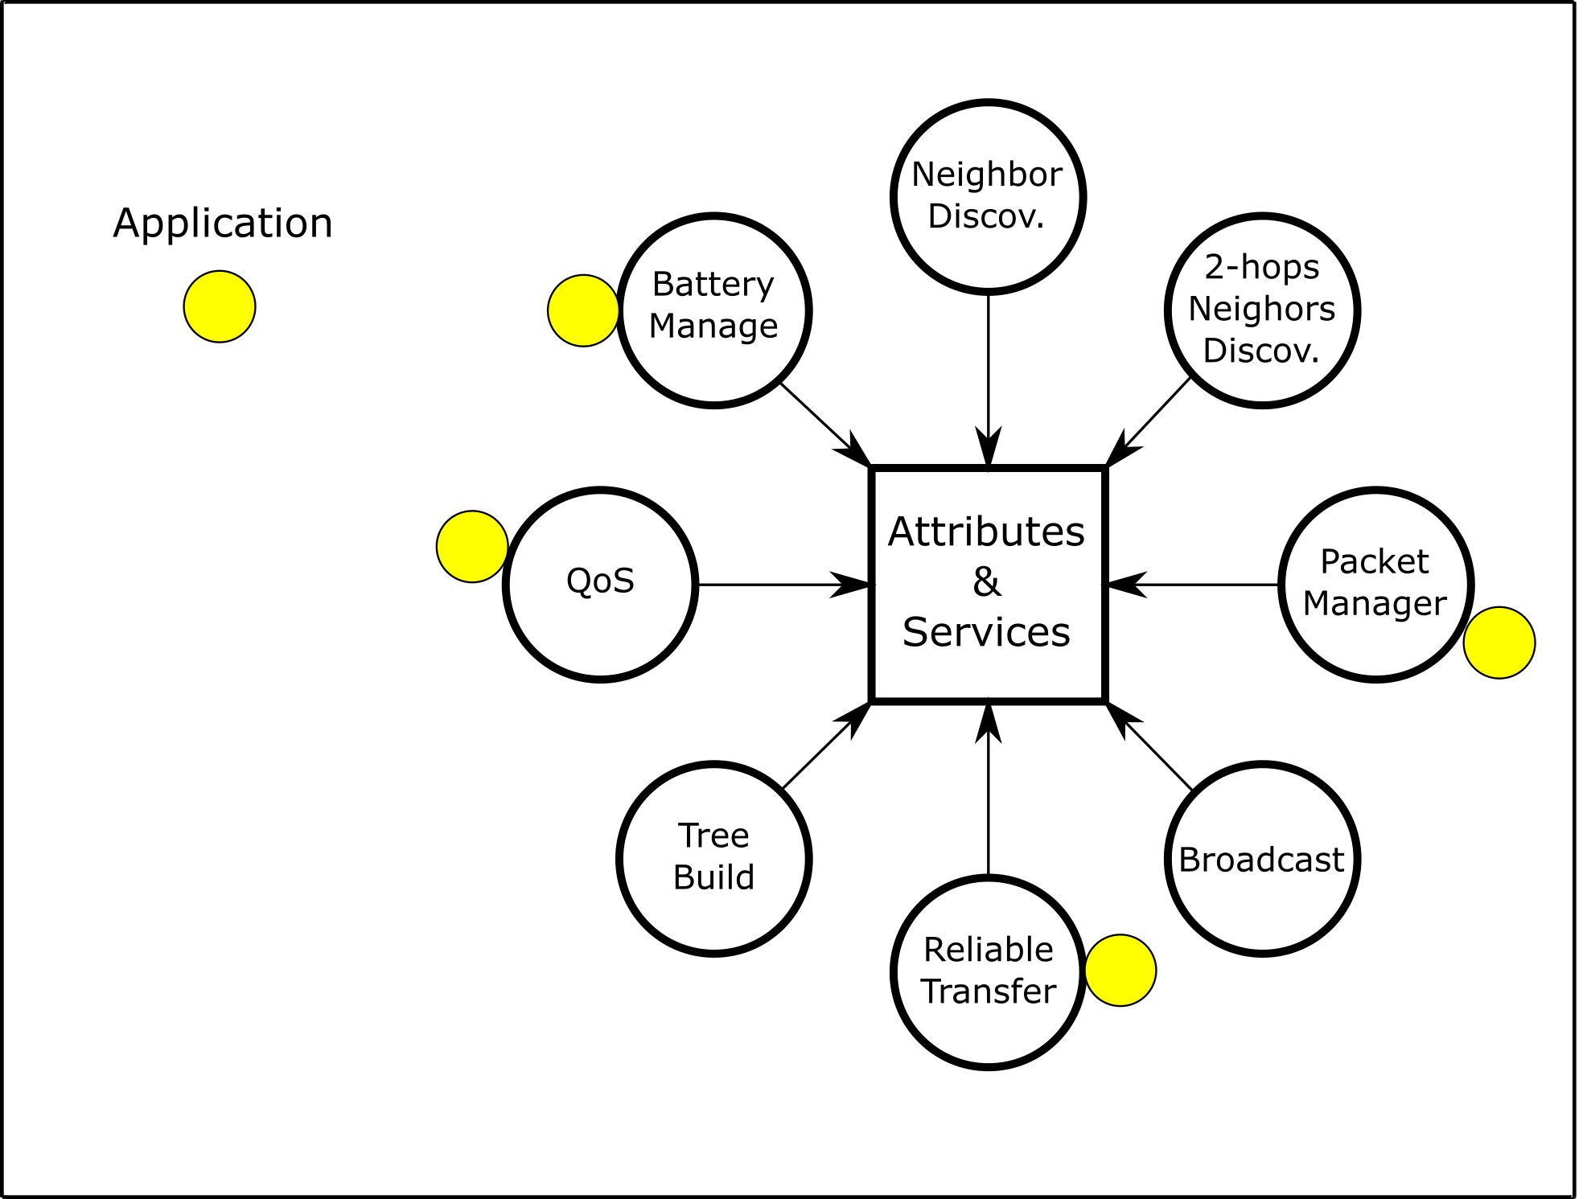
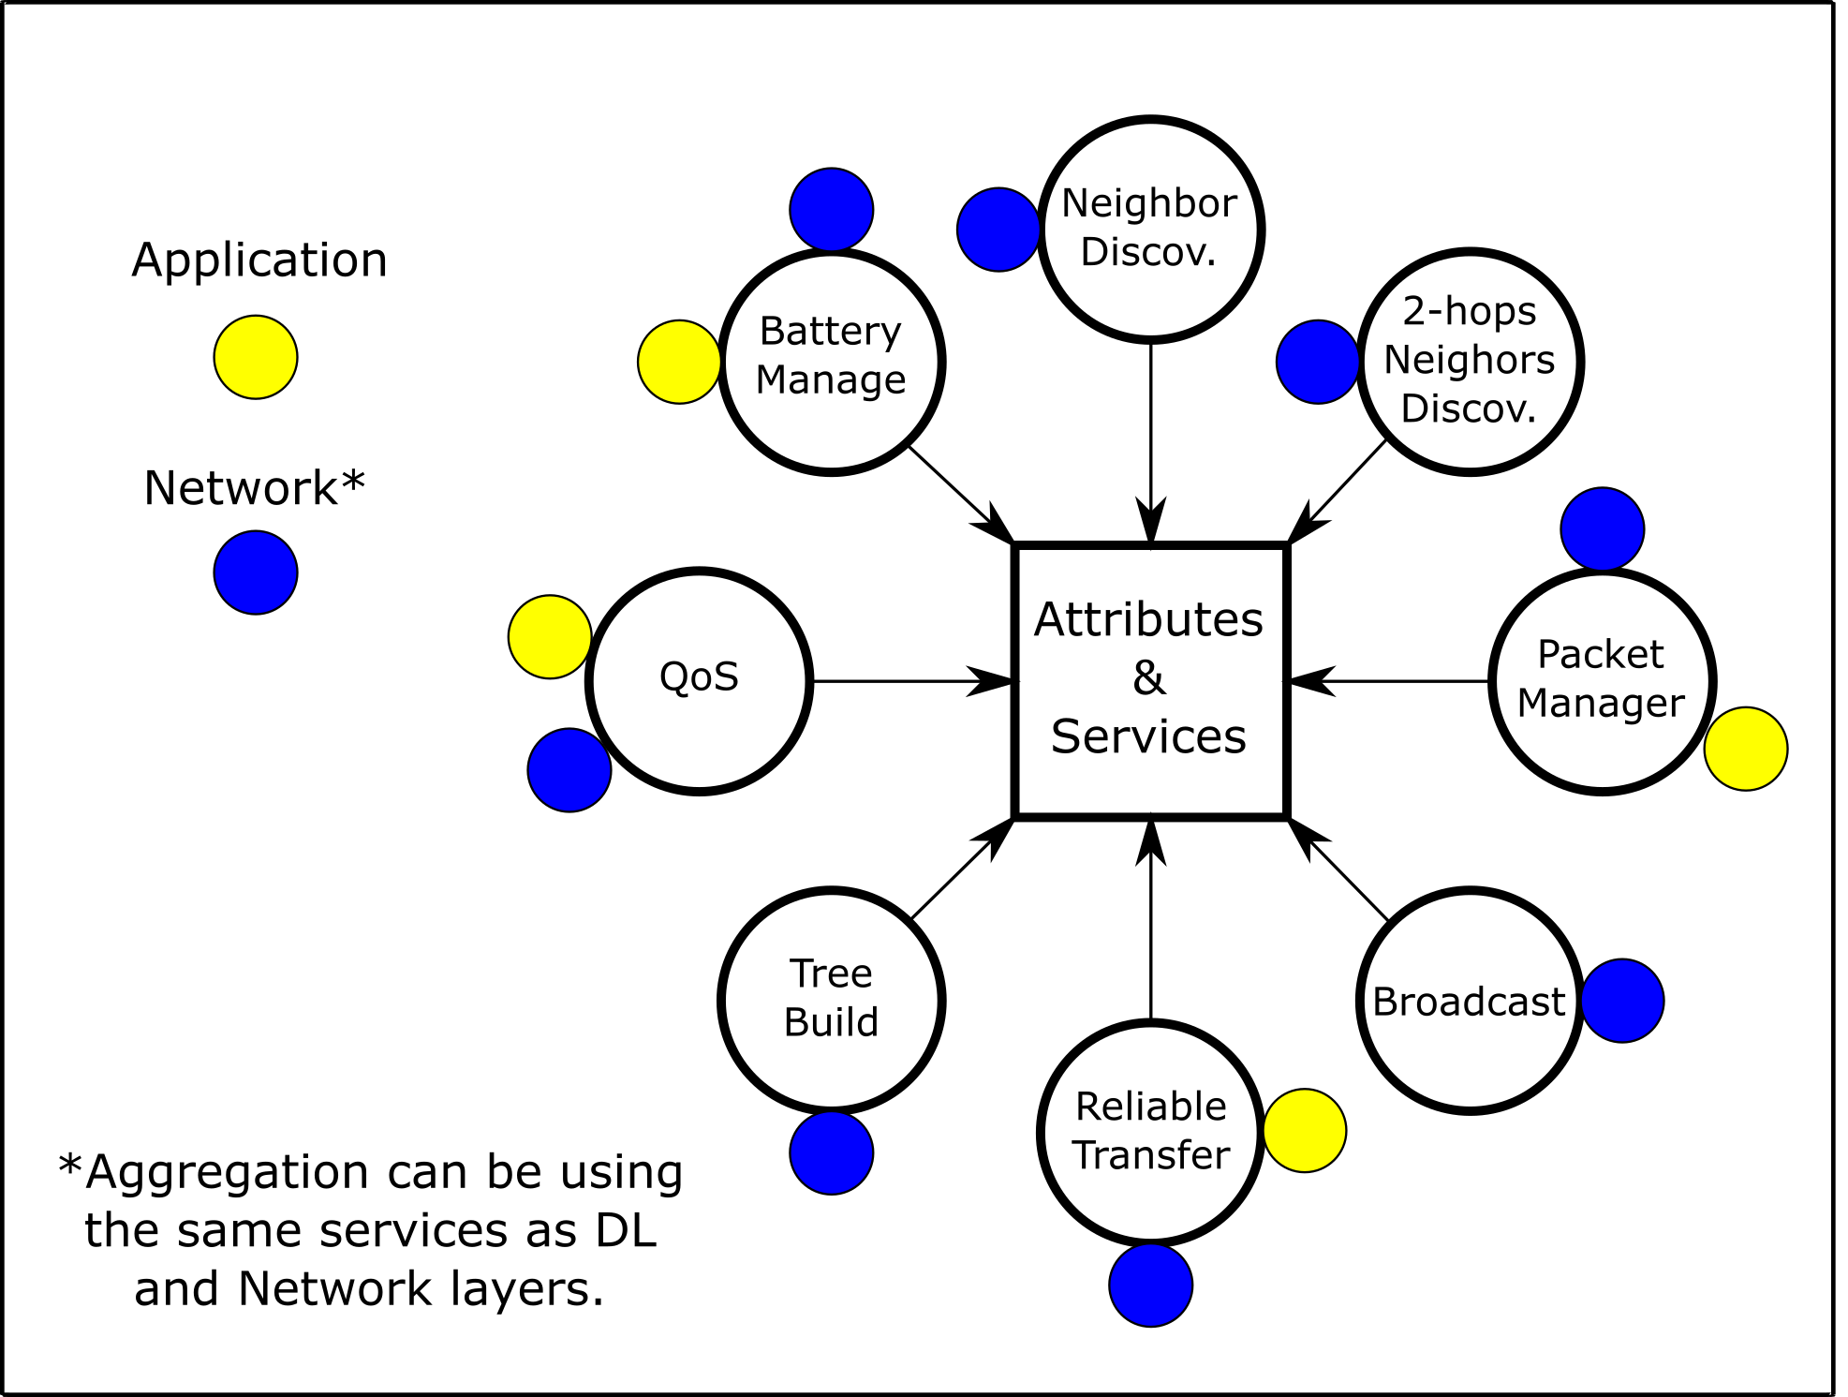
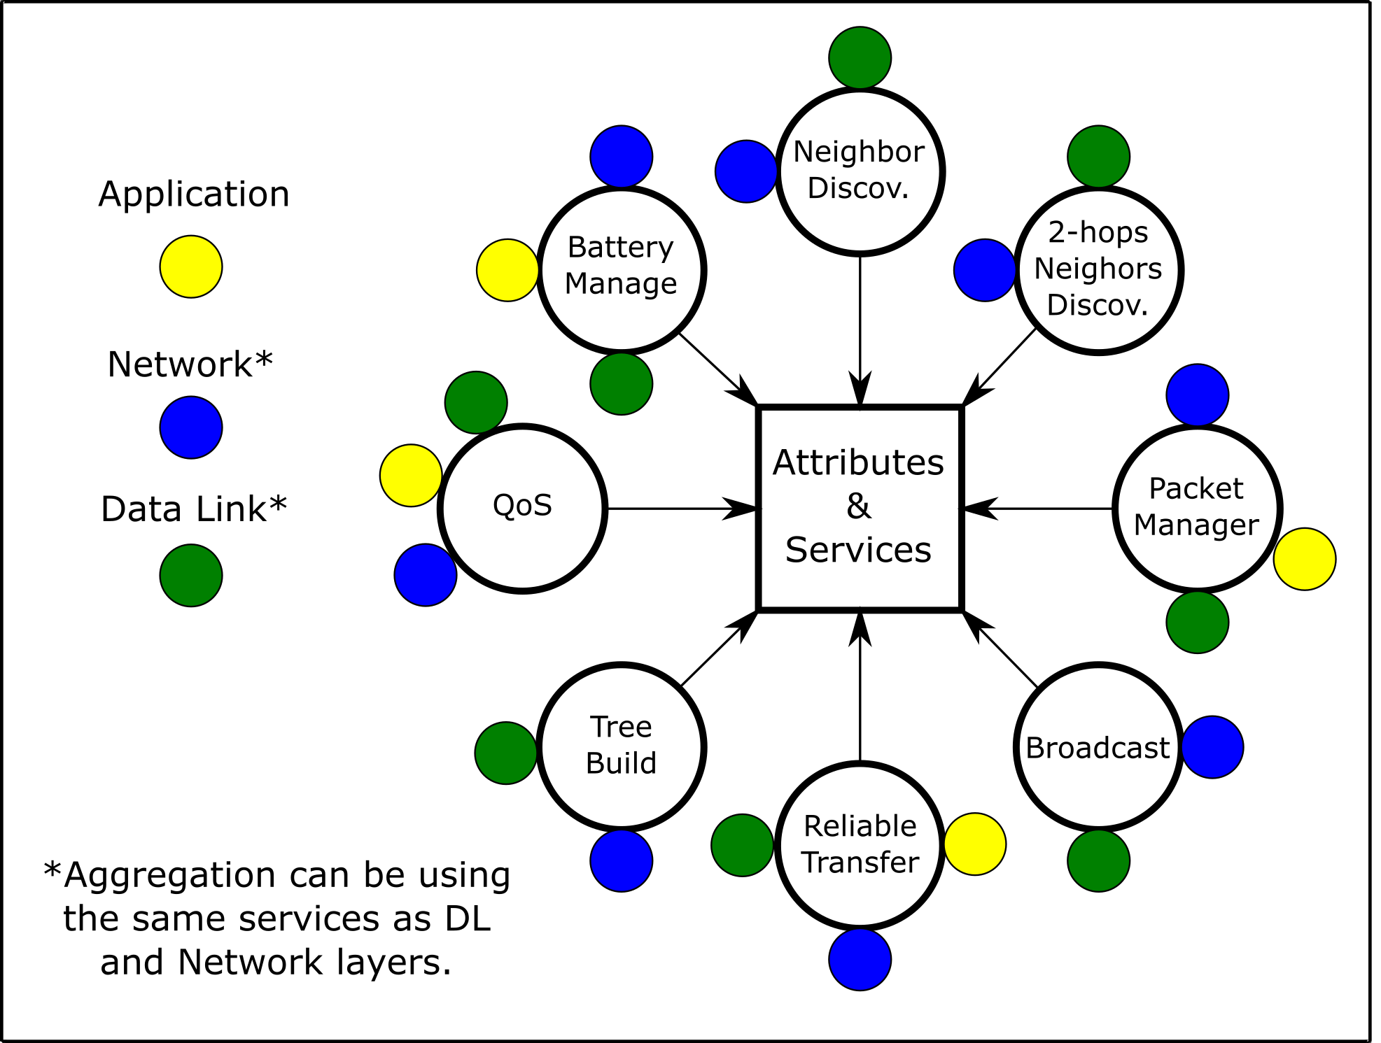
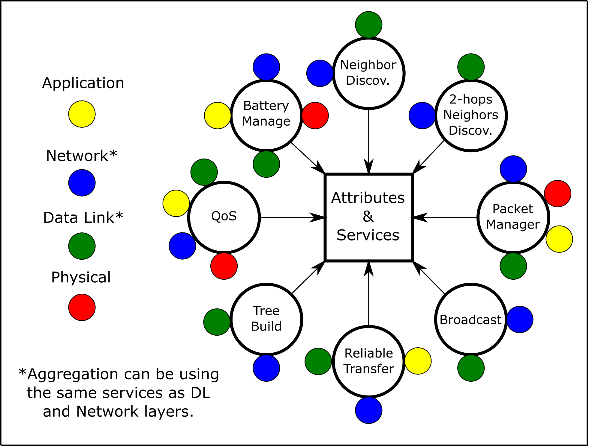
Redundant procedures

Slide 10
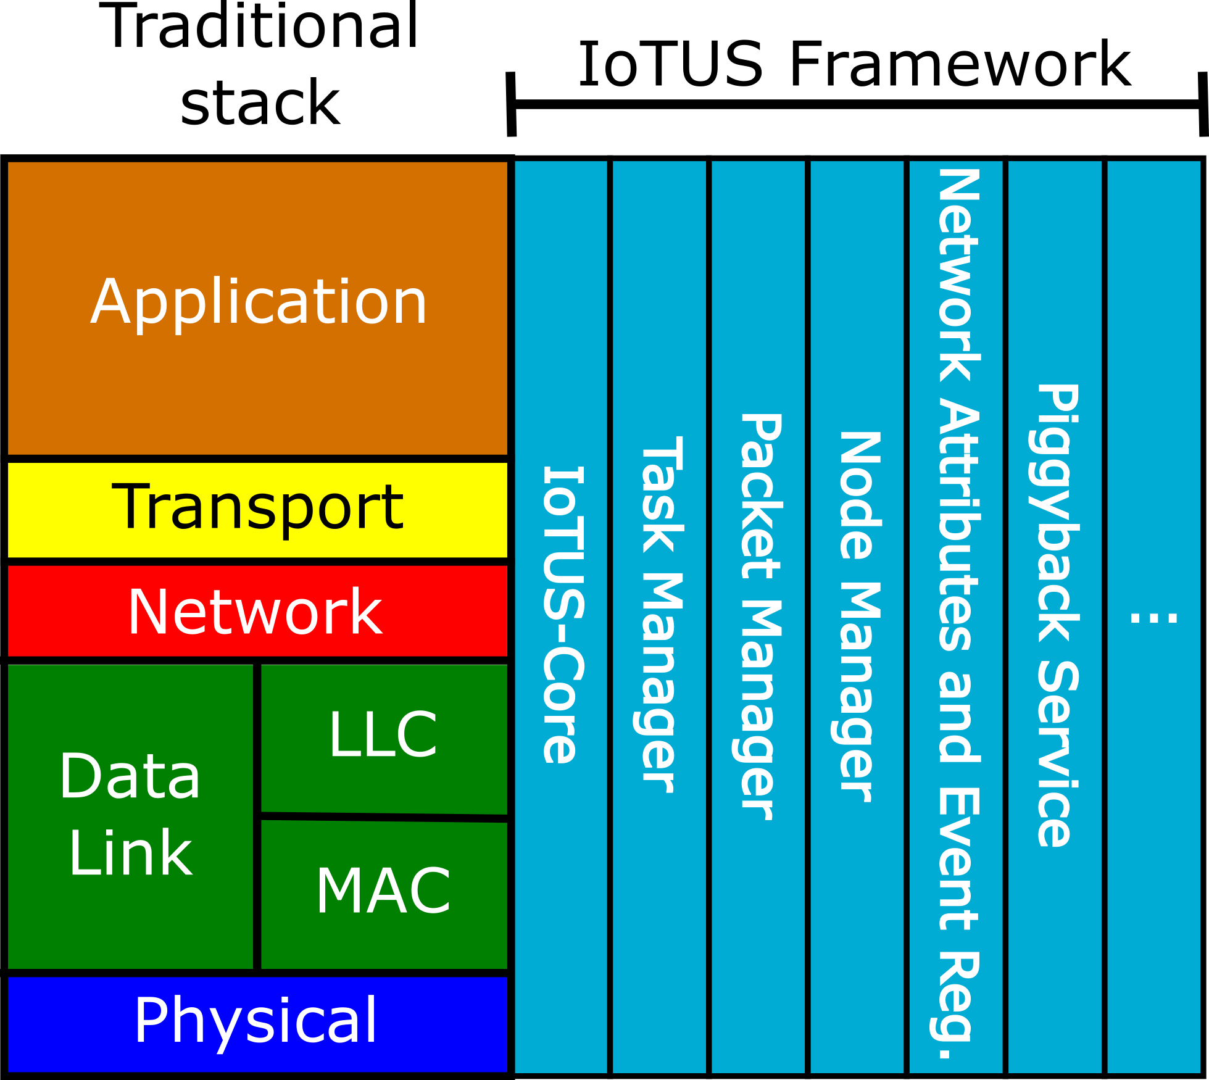
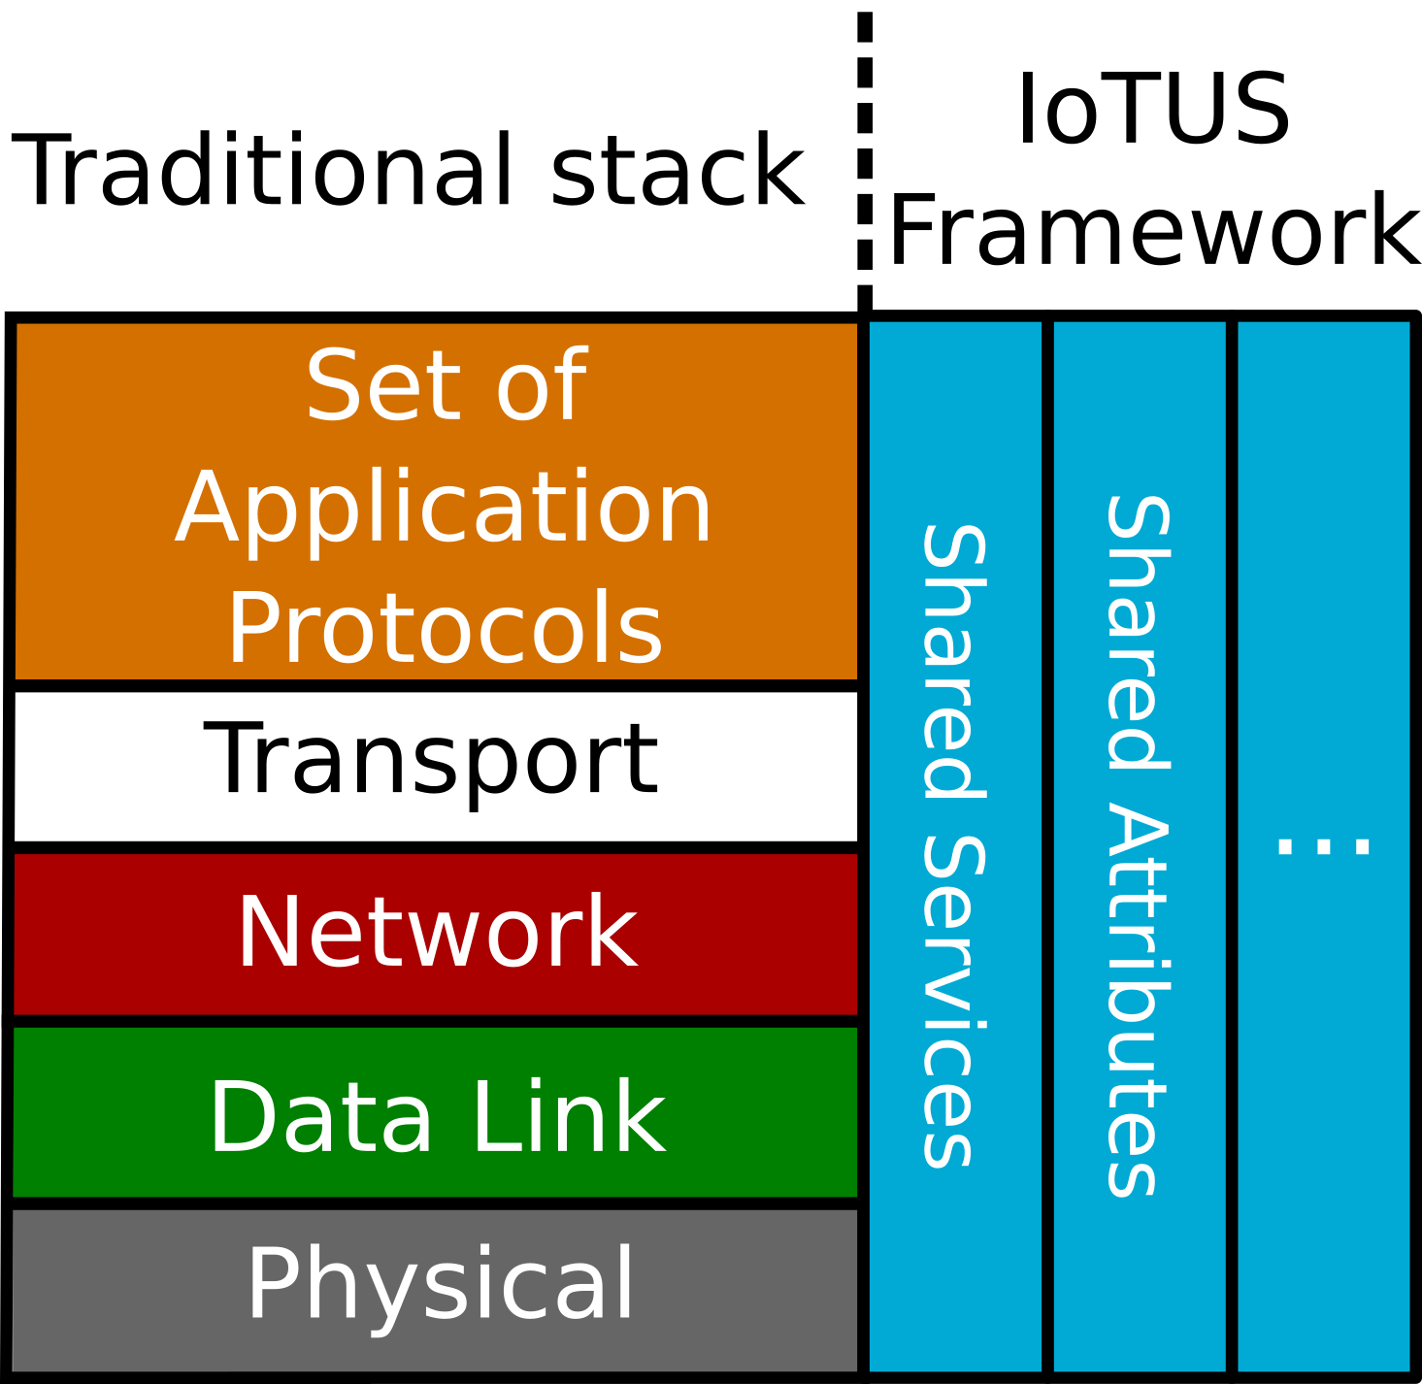
IoT Unified Services (IoTUS) framework
Does not require any specific protocol;
It is not stack specific;
Expandable modules of services;
Does not require protocol redesign;
Functions are additional to the stack.
Notes:
Desenvolvido inteiramente por nós
Conjunto de modulos que preveem serviços para stacks

Slide 11
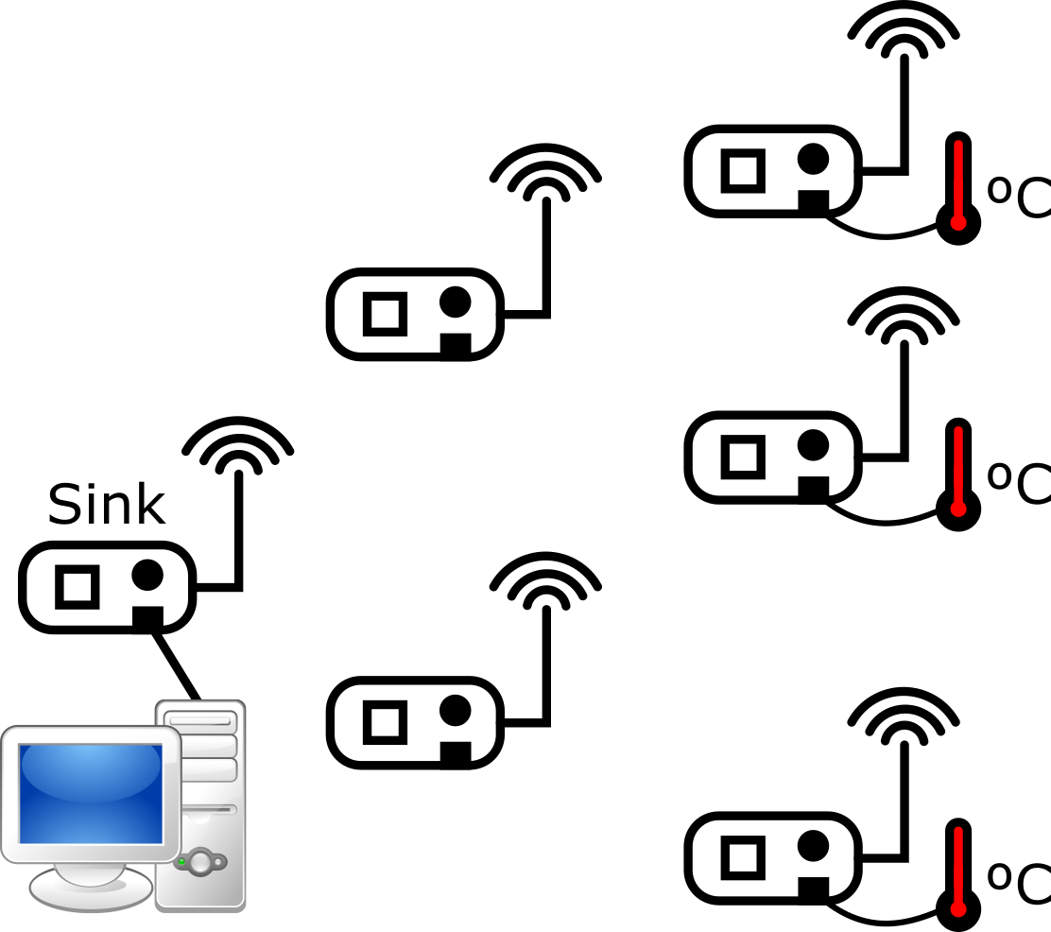
Example – Environment measuring

Slide 12
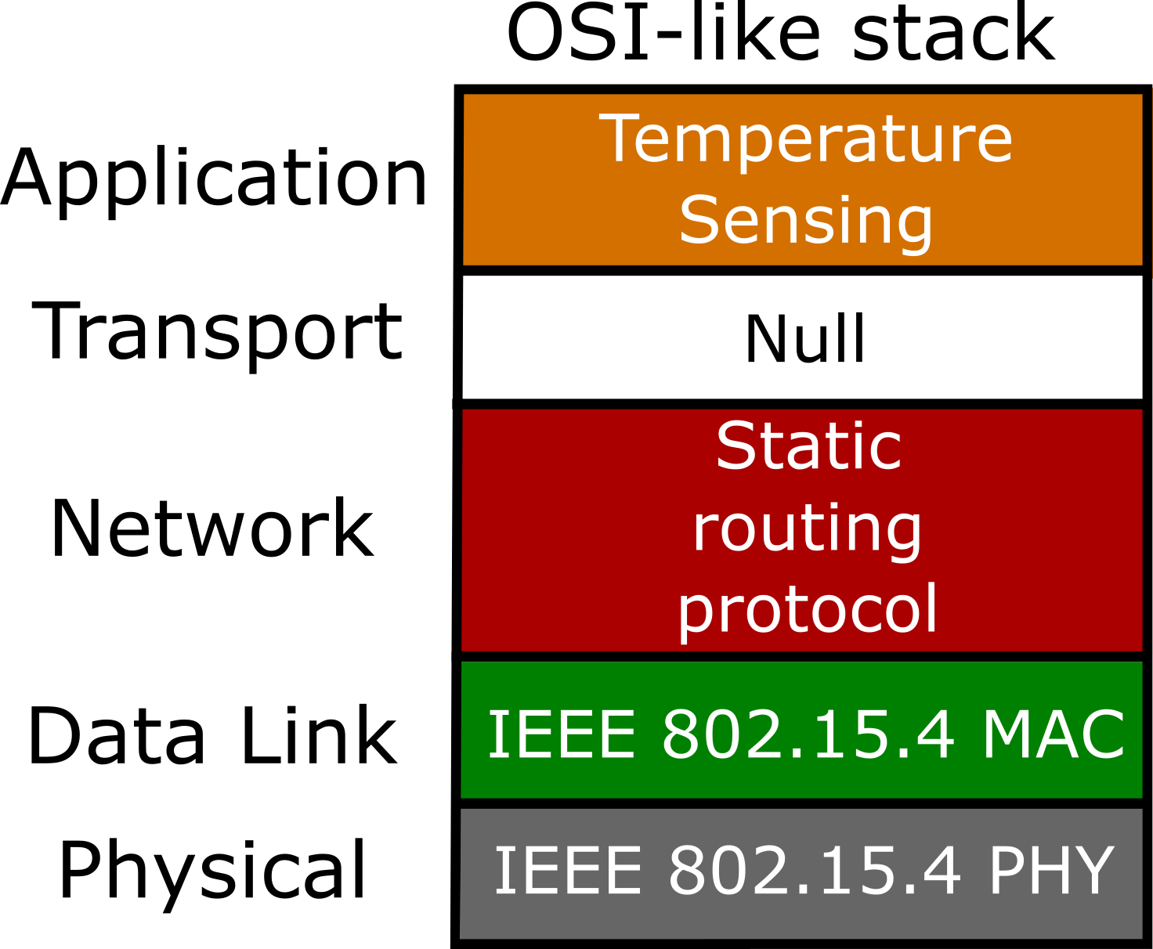
Example of protocols in the Stack
Periodic messages
Periodic Keep Alive

Slide 13
Application runtime
Device initialization;
Message construction;
Application reports.

Slide 14
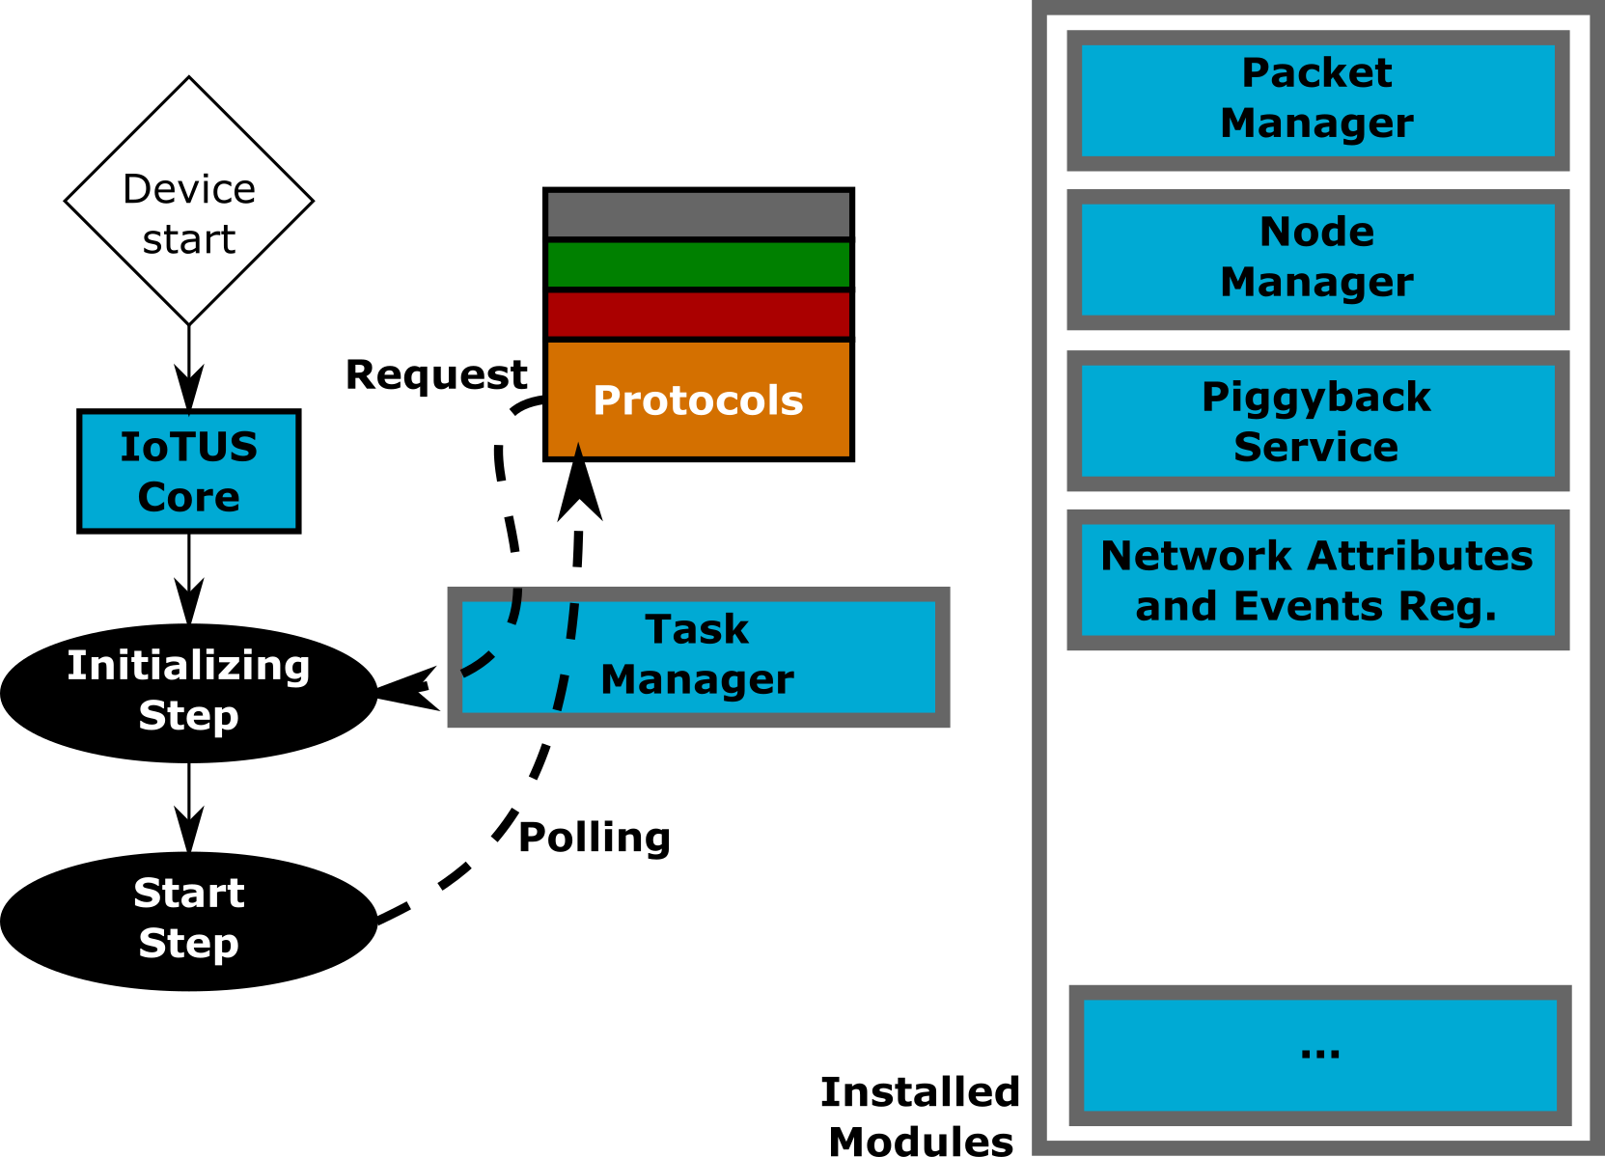
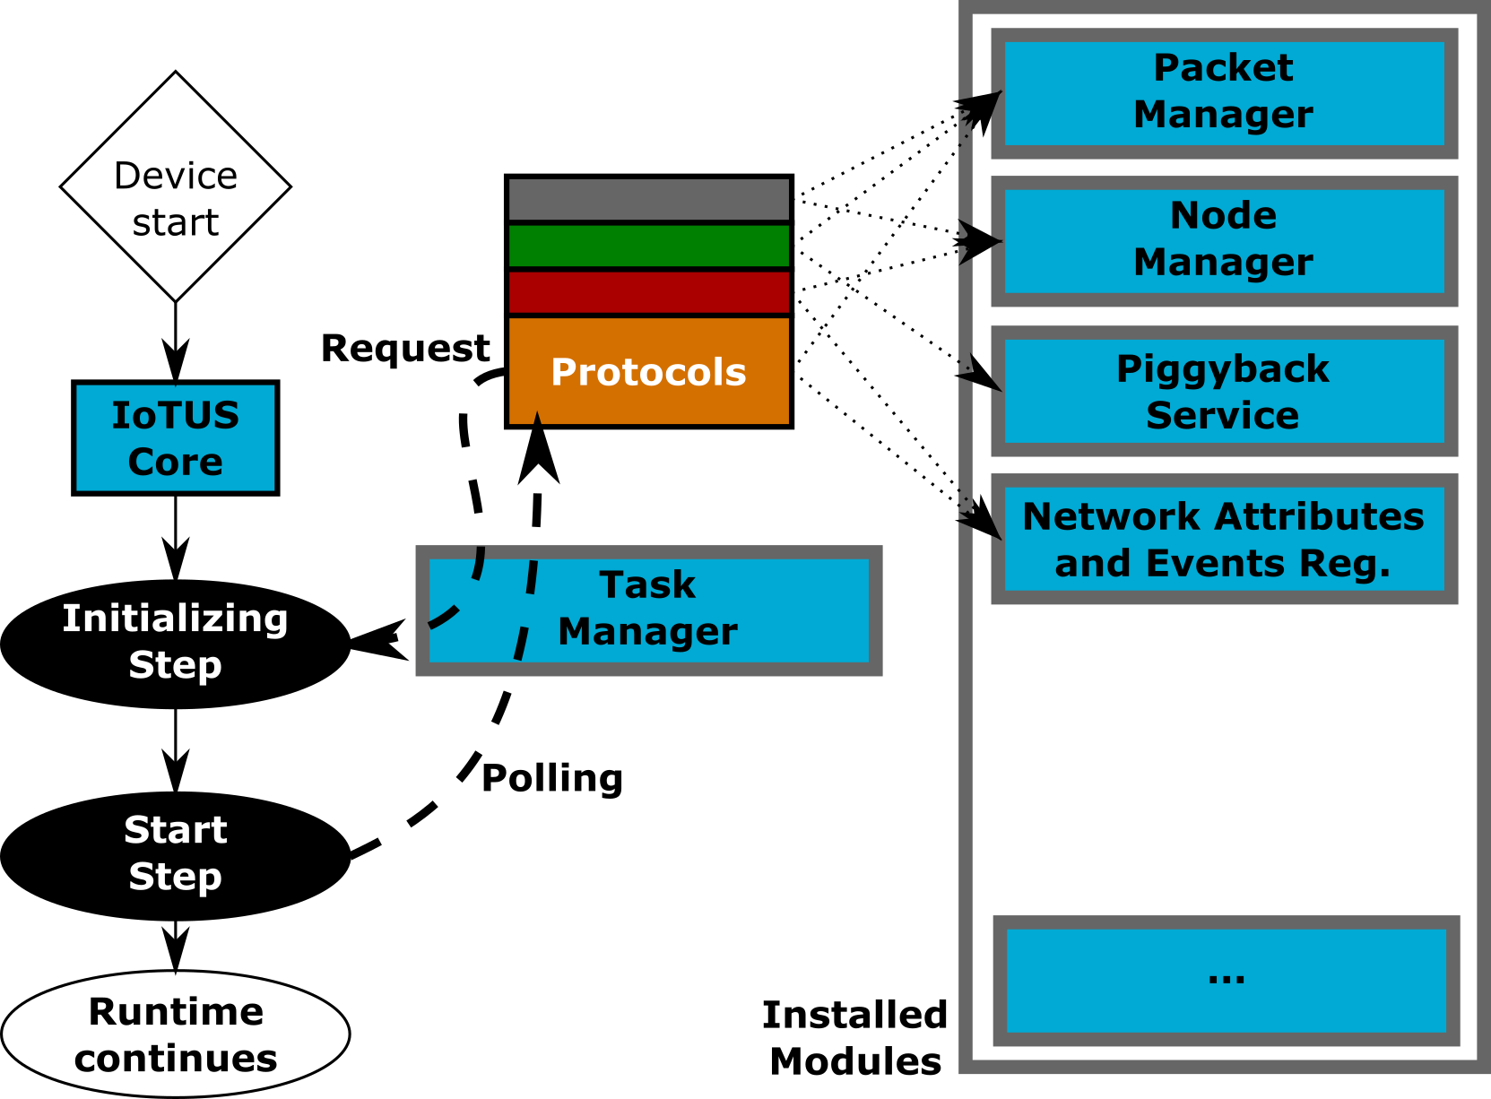
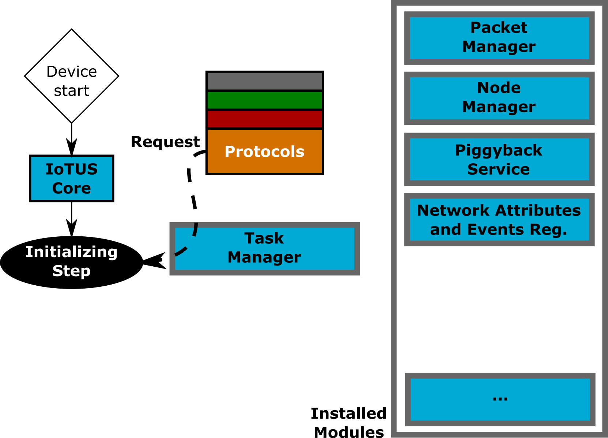
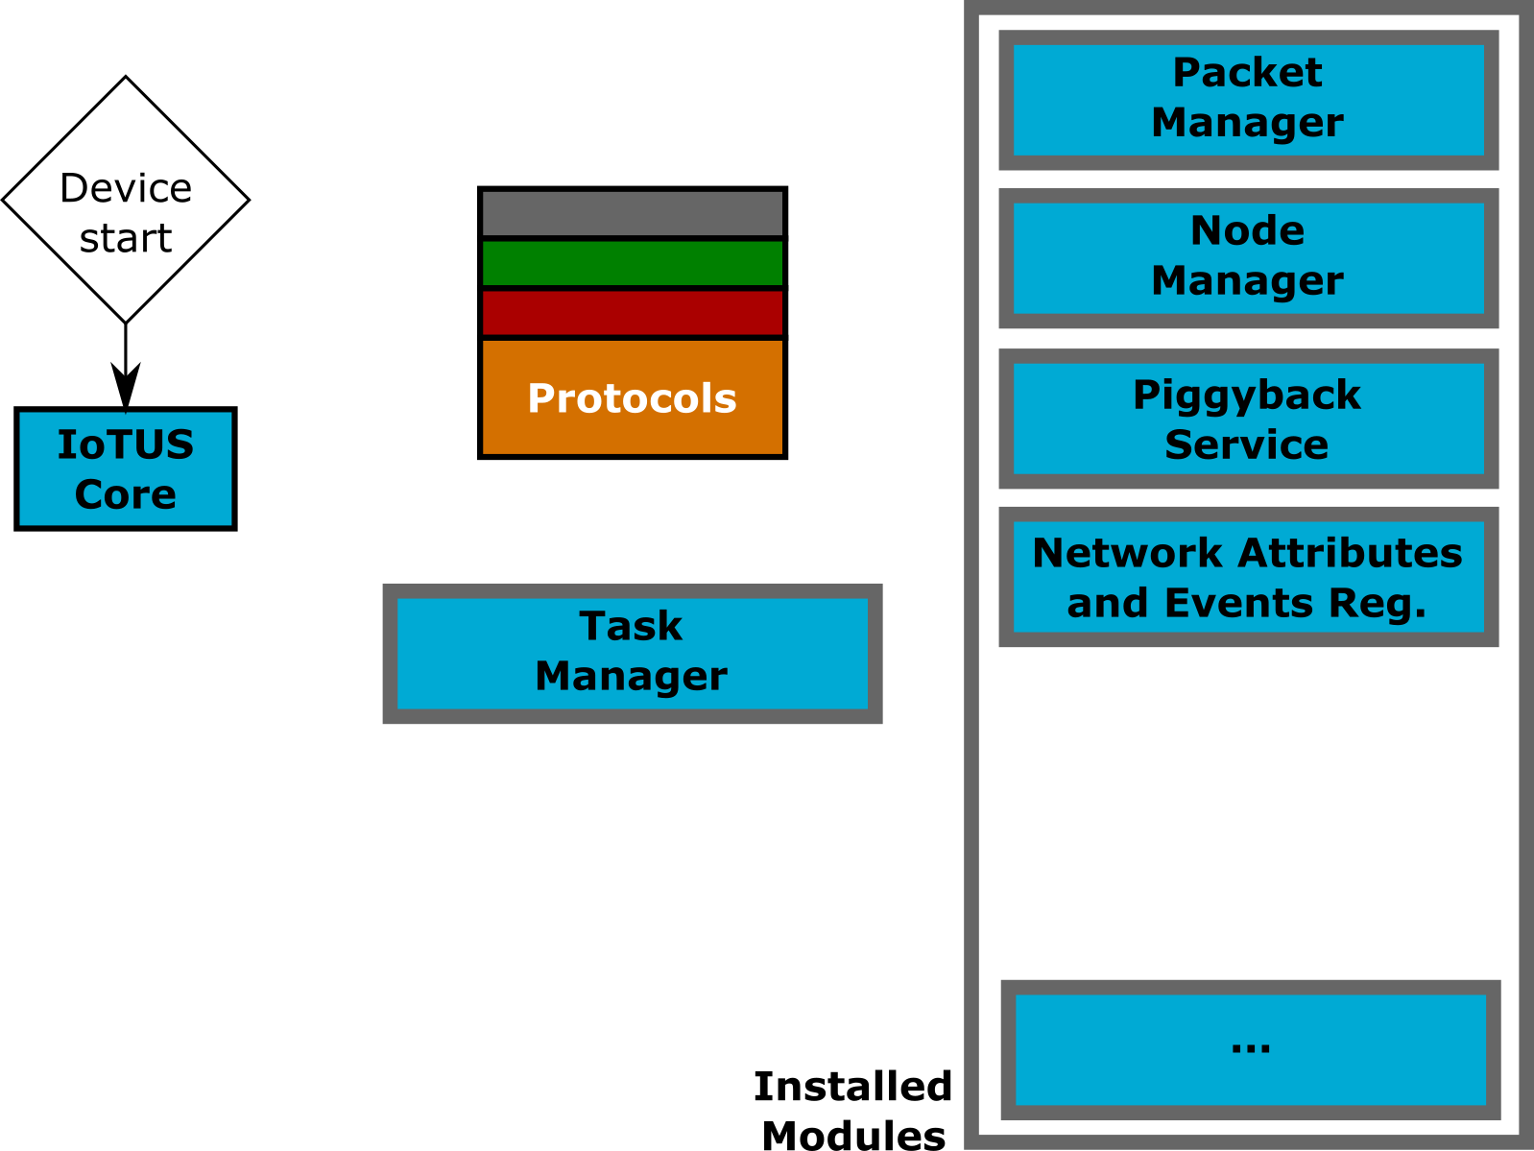
IoTUS–Core: runtime stage

Slide 15
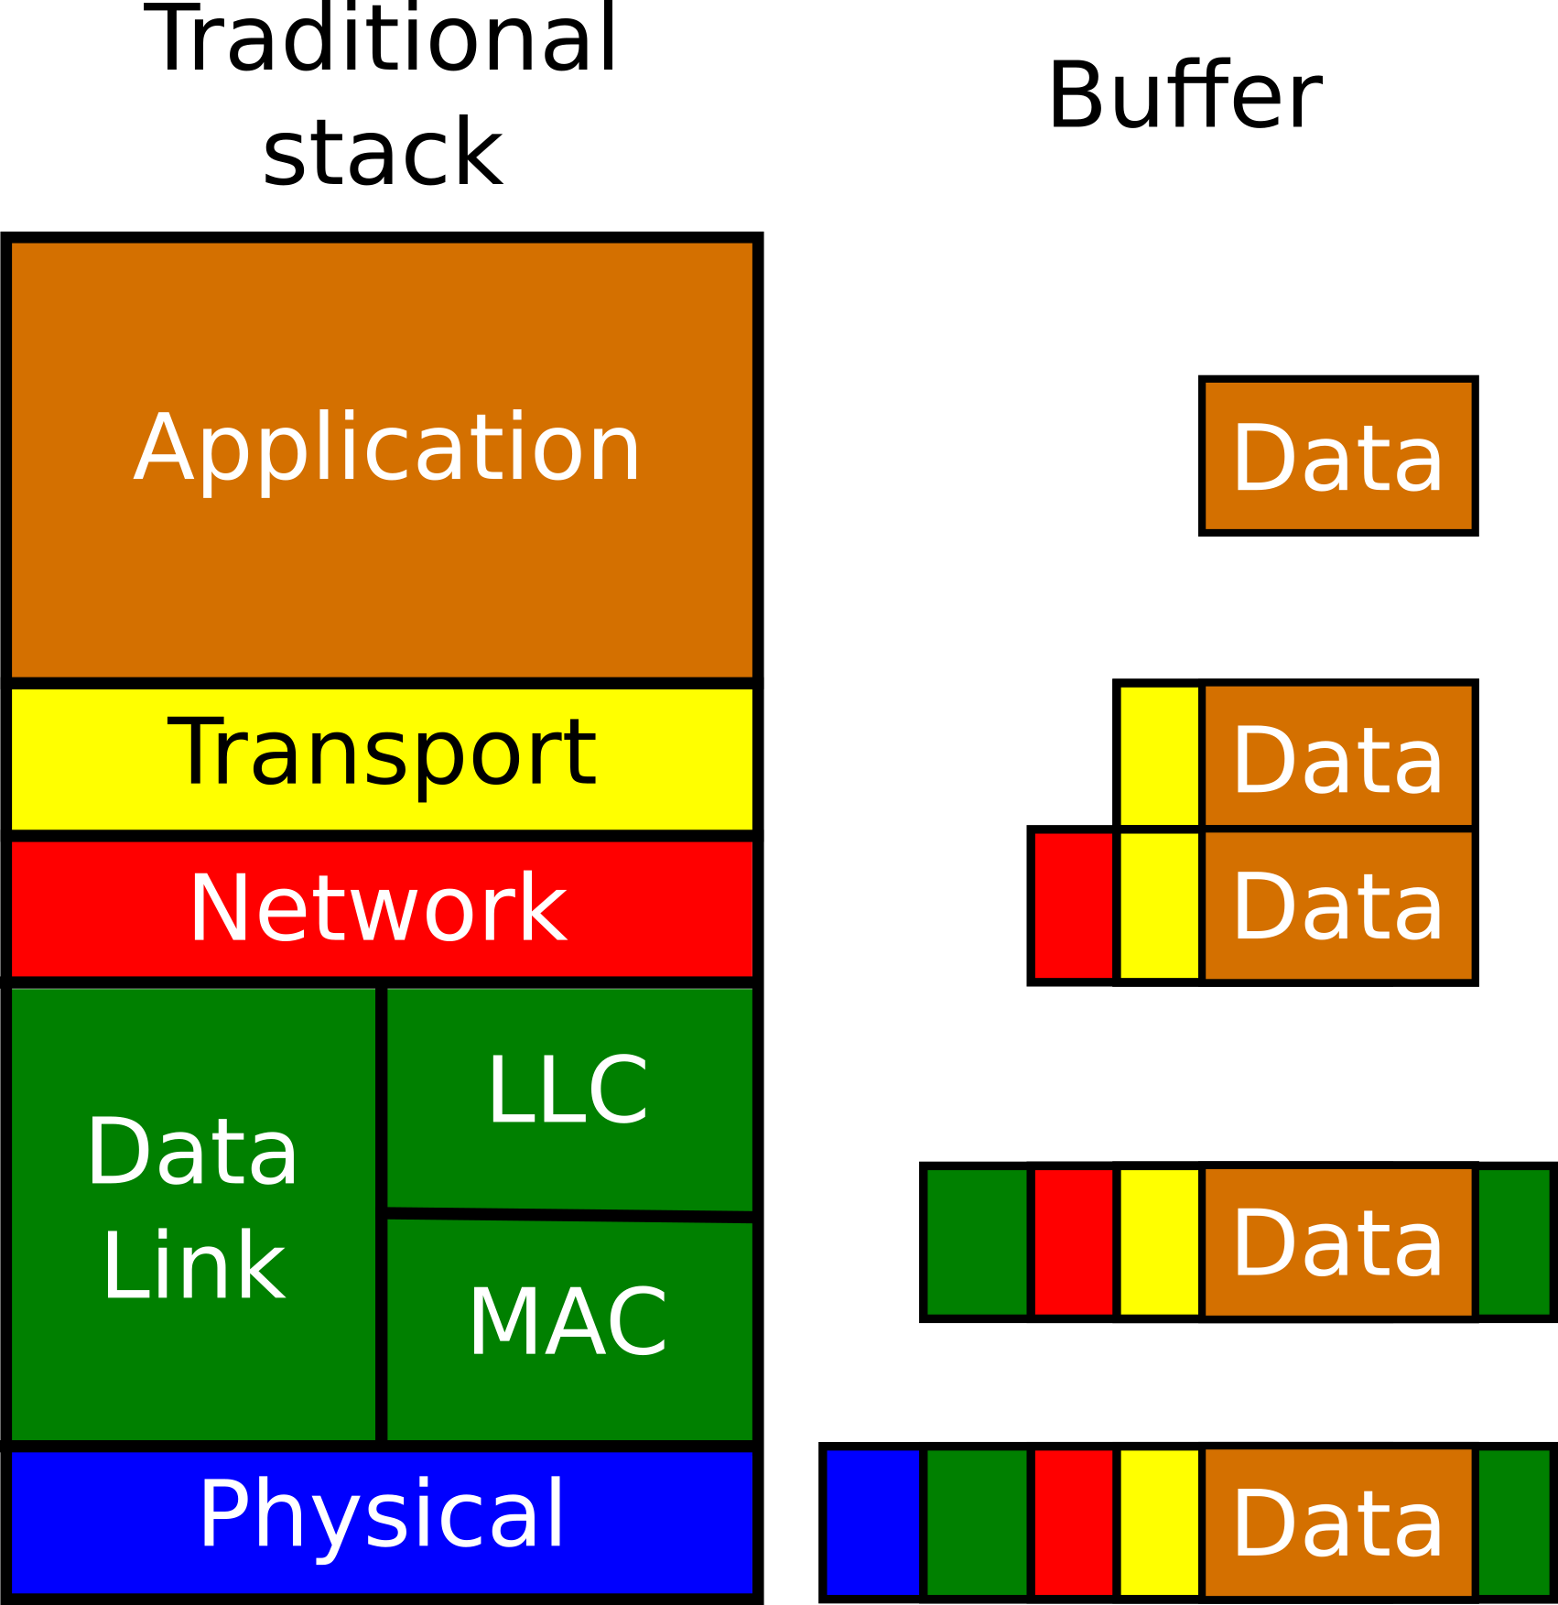
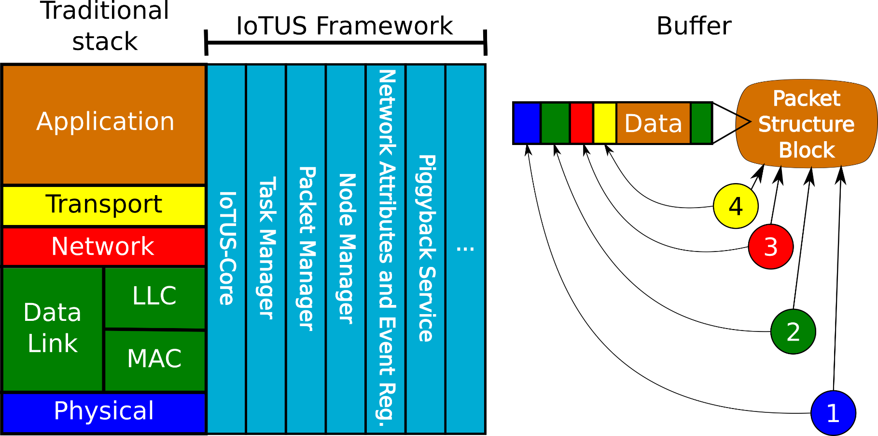
Building packets – Packet Service

Slide 16
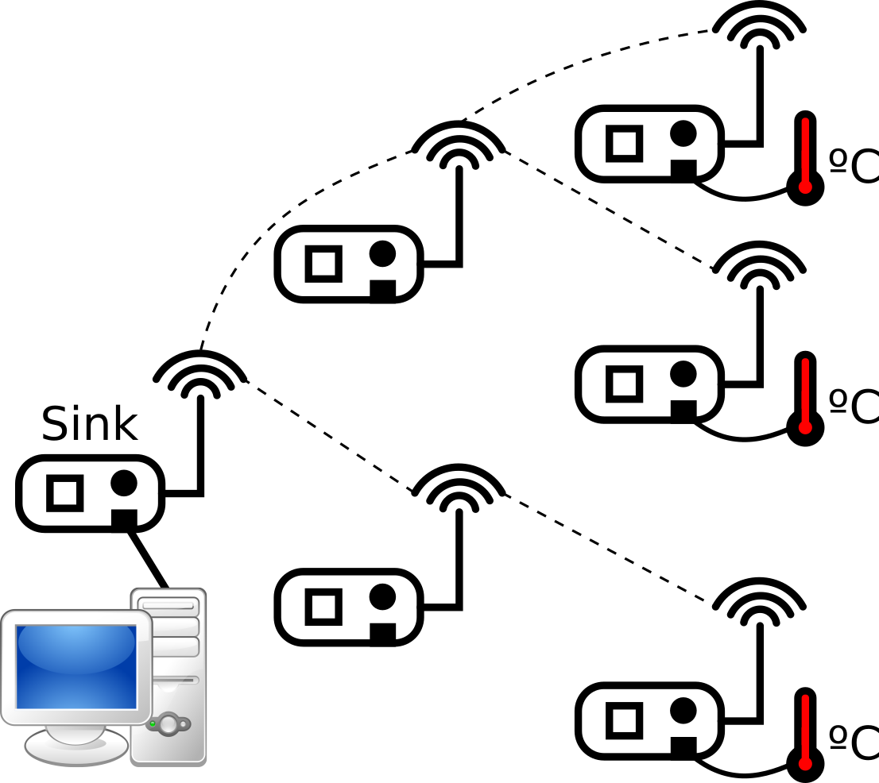

Communication - Standard stack
Application message
Routing layer control

Slide 17
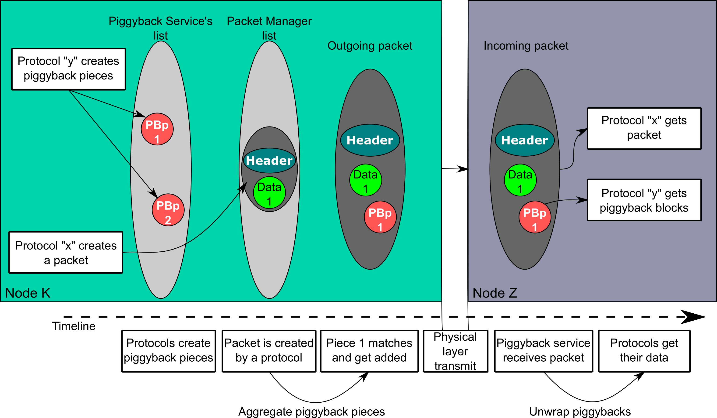
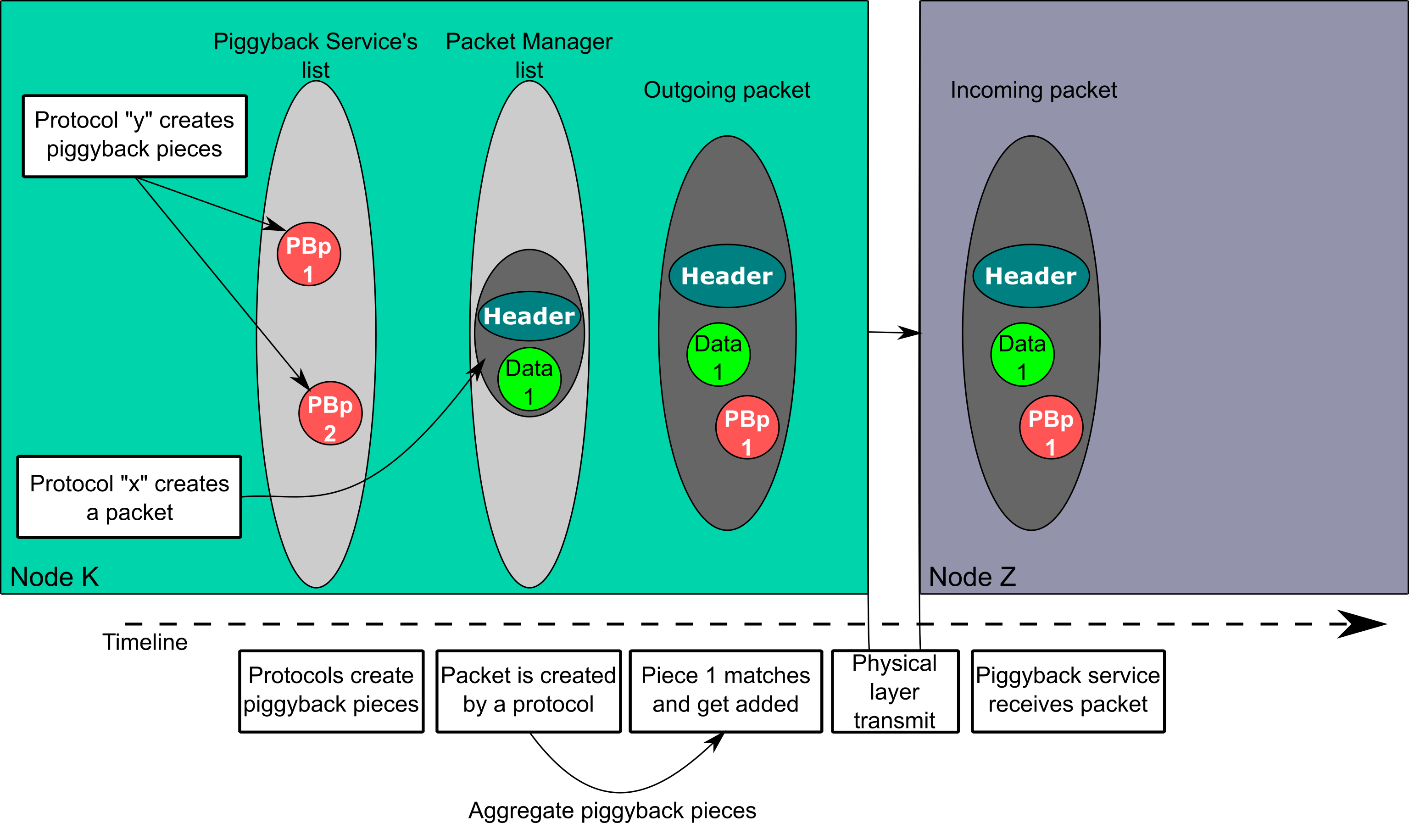
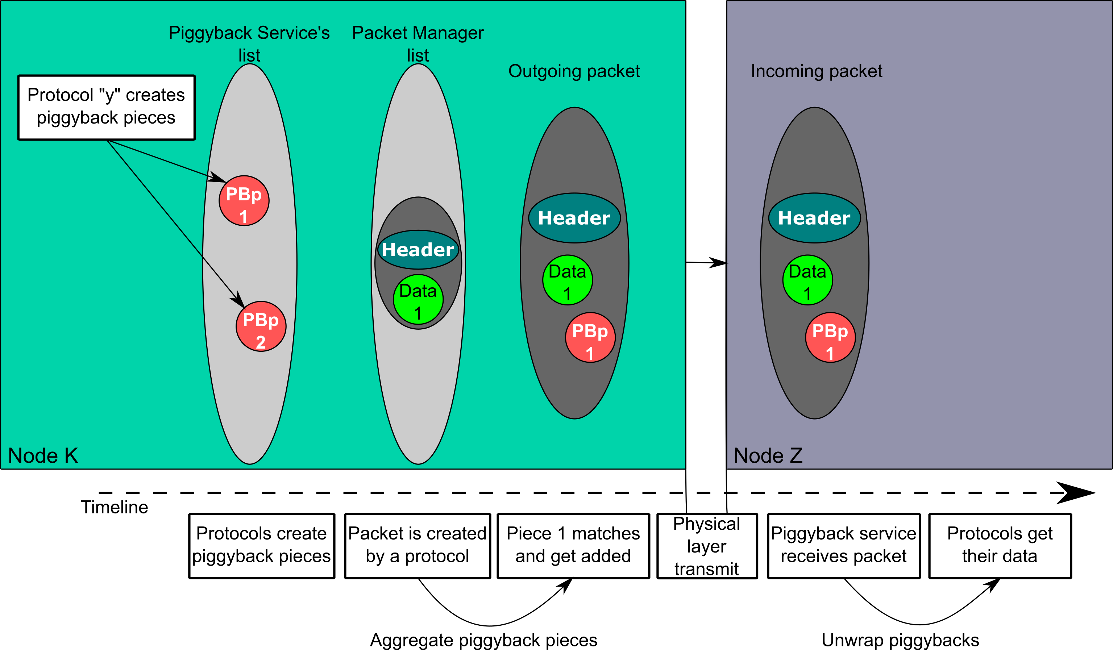
Piggyback Service

Slide 18
Communication – With IoTUS
Application PB piece
Routing layer control
Aggregated packet

Slide 19
IoTUS – Implemented modules
Mandatory:
IoTUS-Core;
Task Manager;
Node Manager;
Packet Manager;
Network Attributes and Events Register;
Safe-Printer.
Optional:
Piggyback Service;
Phase Recorder.

Slide 20
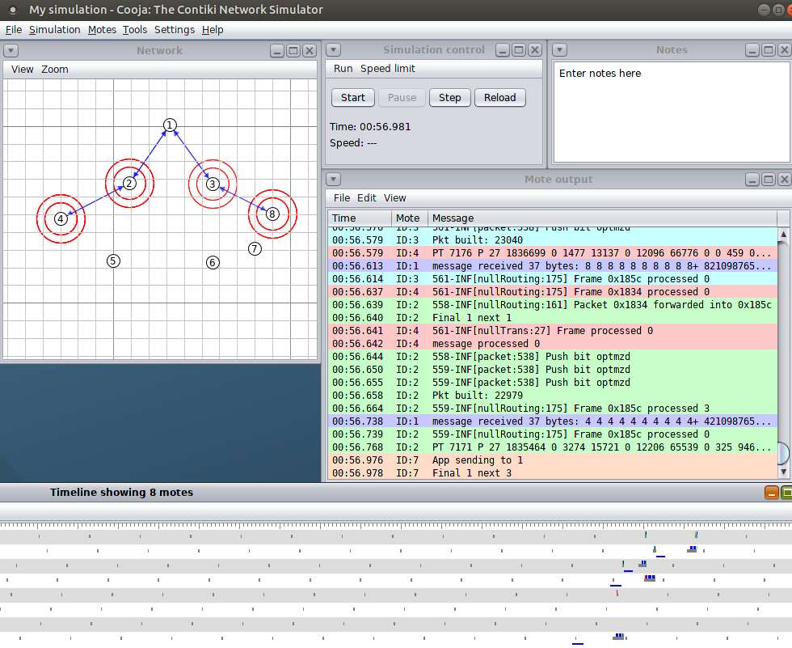
Simulator used – Cooja-ContikiOS
Experimental platform designed for wireless networks;
Controlled environment and reproducible experiments;
Includes an implementation of the Rime protocol stack;
Same code for motes and simulator.

Slide 21
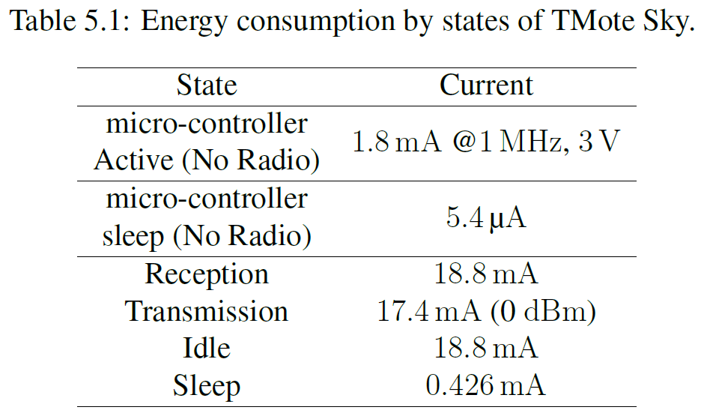
Example of mote consumption
Radio consumption can be 10 times higher!!!

Slide 22
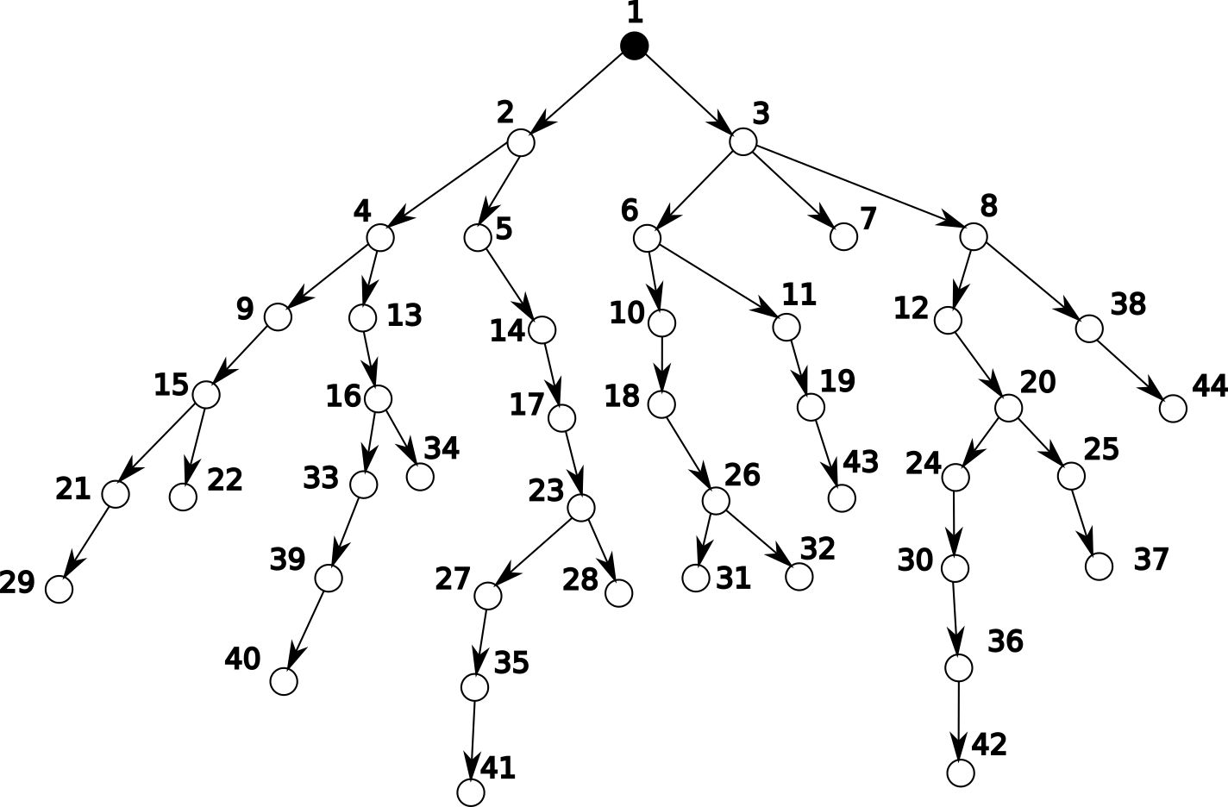
Tree
Parameters:
Energy consumption;
Lifetime;
Memory.

Slide 23
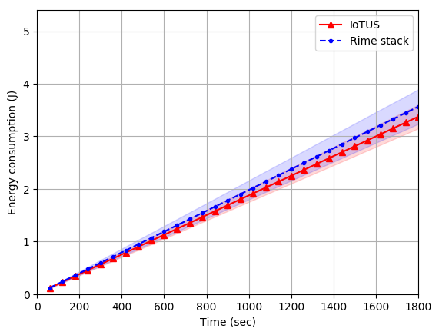
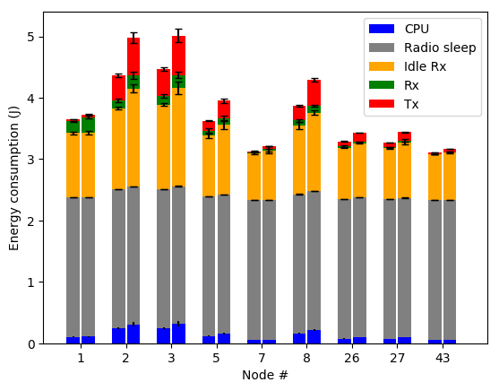
Energy consumption 44 nodes
IoTUS/Rime
5.33%

Slide 24
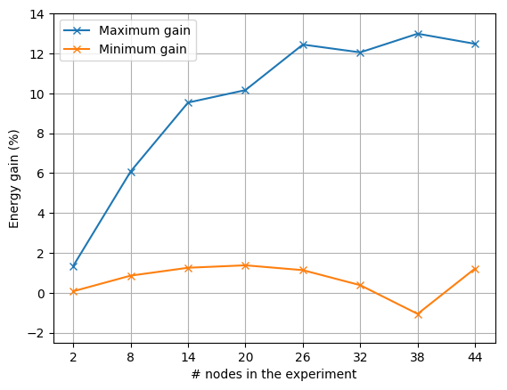
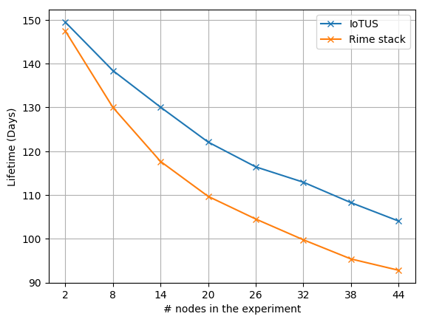
Energy gain & lifetime
IoTUS/Rime 13%
IoTUS
+11 days

Slide 25
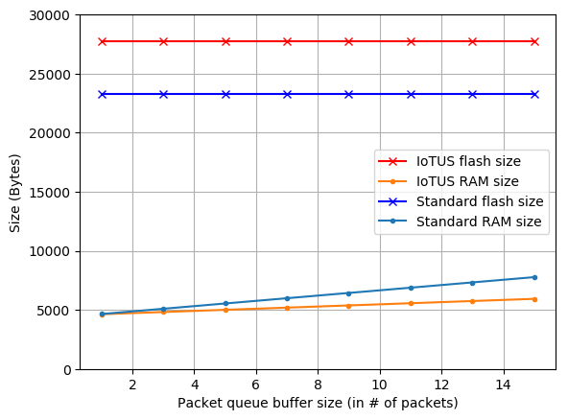
Memory usage
IoTUS/Rime
118.92%
IoTUS/Rime
23.63%

Slide 26
Conclusion
IoTUS framework facilitates cross-layer data and functionality sharing;
It is not protocol or stack specific;
It has an extensible service design;
Increased efficiency compared to traditional stack:
Energy consumption;
Memory usage;
Network lifetime.

Slide 27
Future work
Implement IoTUS with other protocols;
Test IoTUS in real-world testbeds;
Evaluating latency performance;
Extend the experiments to other applications.

Slide 28





Acknowledgements
Laboratory Automation and Robotics
Research Group in Advanced Wireless Networks
Graduate Program in
Electronic Systems and Automation — UnB
Universidade de Brasília
Coordenação de Aperfeiçoamento de
Pessoal de Nível Superior
INTERNETWORKING RESEARCH
GROUP — UCSC

Slide 29
Thank you!
Vinícius G. Guimarães - vinicius_galvao@msn.com
Adolfo Bauchspiess – adolfobs@ene.unb.br
Renato M. de Moraes - renatomdm@cin.ufpe.br
Katia Obraczka - katia@soe.ucsc.edu

Slide 30
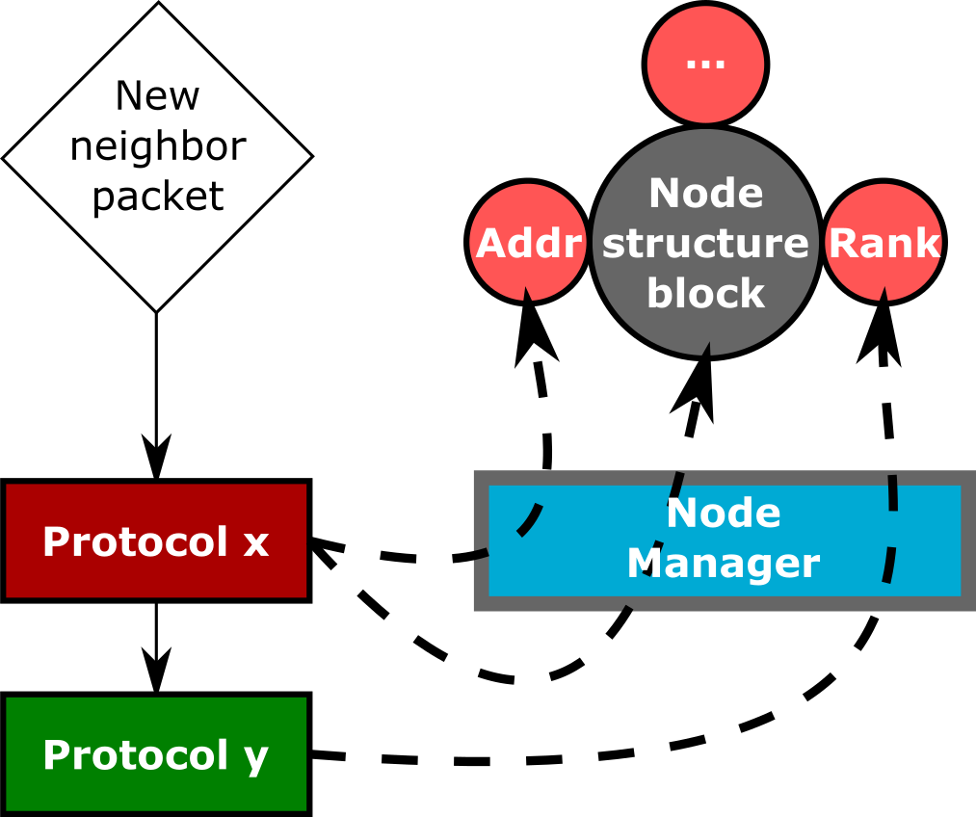
Other modules
Nodes Manager

Slide 31
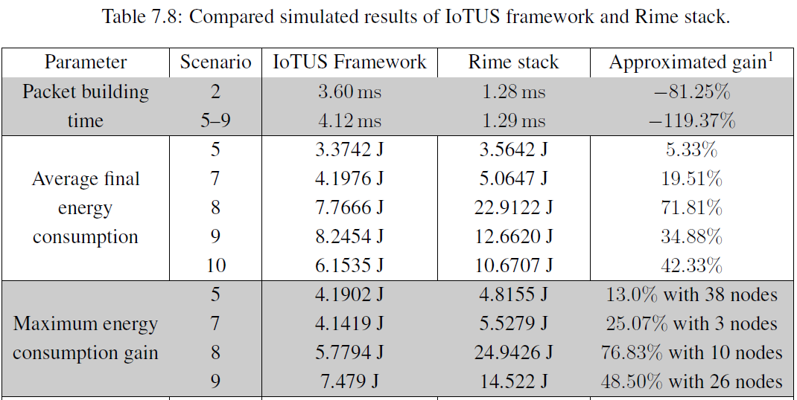

Overall scenario comparison

Slide 32
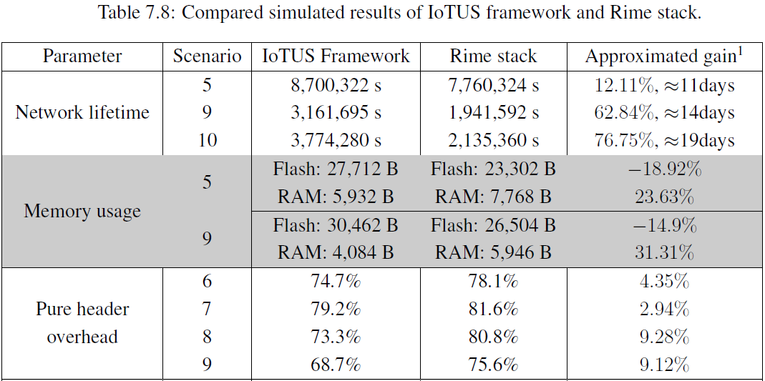
Overall scenario comparison

Slide 33
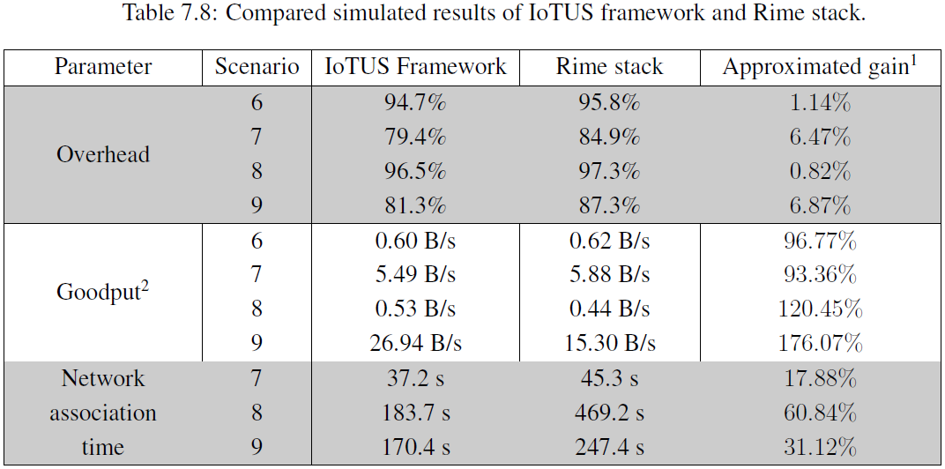
Overall scenario comparison

Slide 34
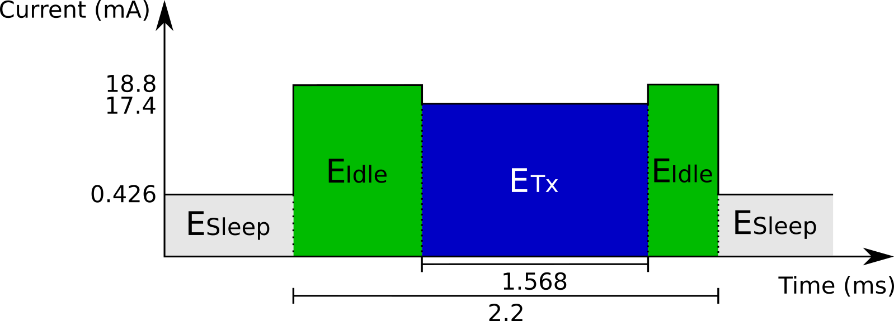
Energy consumption equation
where State represents the Sleep, Idle, Tx, and Rx states.
Simulation tools:
Powertrace;
PowerTracker.

Slide 35
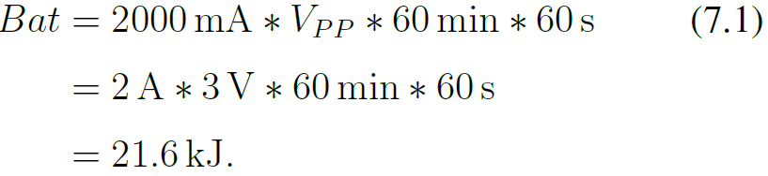
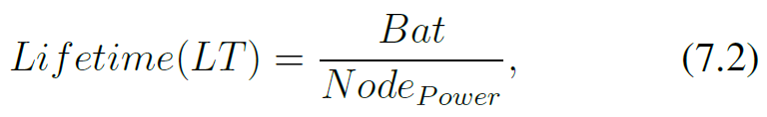
Network lifetime
Time until any of the nodes’ battery depletes;
It was considered a battery of 2000mAh:
where Node_{Power} represents the average power consumption.

